Slide 1
Homes and mobility
without lifelong debt
Twenty pictured Alibaba listings for modular two-bedroom housing and low-cost electric transport
A market screen, not an endorsement
UK prices, permissions and road legality remain separate checks
Prepared 12 September 2026
Notes:
Alibaba listings change frequently. Prices and marketplace signals in this deck are snapshots.
Sources checked 12 September 2026:
https://m.alibaba.com/countrysearch/CN/customized-homes.html
https://www.alibaba.com/countrysearch/CN/electric-car-eec-certificate.html

Slide 2
The structure can be cheap while access remains expensive
Factory price proves that the physical shell is only one part of housing and transport cost
01
02
03
04
Factory product
Movement
Permission
Place
Steel frame, panels, doors, windows and fitted options
Ocean freight, insurance, customs, port handling and local delivery
Planning, building control, vehicle approval, registration and insurance
Land, drainage, power, water, access, ground engineering and maintenance
Affordable structures already exist. Public choices determine whether people can lawfully and safely use them.
02
Notes:
Sources checked 12 September 2026:
https://www.gov.uk/import-goods-into-uk
https://www.gov.uk/planning-permission-england-wales
https://www.gov.uk/building-regulations-approval
https://www.gov.uk/importing-vehicles-into-the-uk

Slide 3
What the shortlist measures
A rapid market screen using public listing data and official UK guidance
HOUSING
VEHICLES
Two-bedroom wording or a configurable layout
Advertised product price below £5,000
Advertised product price from roughly £3,000 to £20,000 for a plausible two-bedroom configuration
A range of uses including short personal trips, accessible mobility, family transport, cargo, farm and refrigerated delivery
Expandable or modular form that can sit on engineered hardstanding, pads or piles without a full concrete slab
Exact Alibaba product-page URL paired with its Alibaba-hosted photograph in the public image index
Rock wool named in the listing or available only after written specification
Review and sold counts change quickly. Recheck them on Alibaba before ranking suppliers
A photograph proves the offer appears in the marketplace index. It does not prove the delivered specification or UK approval.
PRICE RULE: green means an indexed figure was visible; amber means the seller price was not independently readable and the slide uses a stated planning allowance.
03
Notes:
Sources checked 12 September 2026:
https://m.alibaba.com/countrysearch/CN/customized-homes.html
https://autopart.alibaba.com/product/cheapest-cars
https://autopart.alibaba.com/product/3-wheel-electric-cars

Slide 4
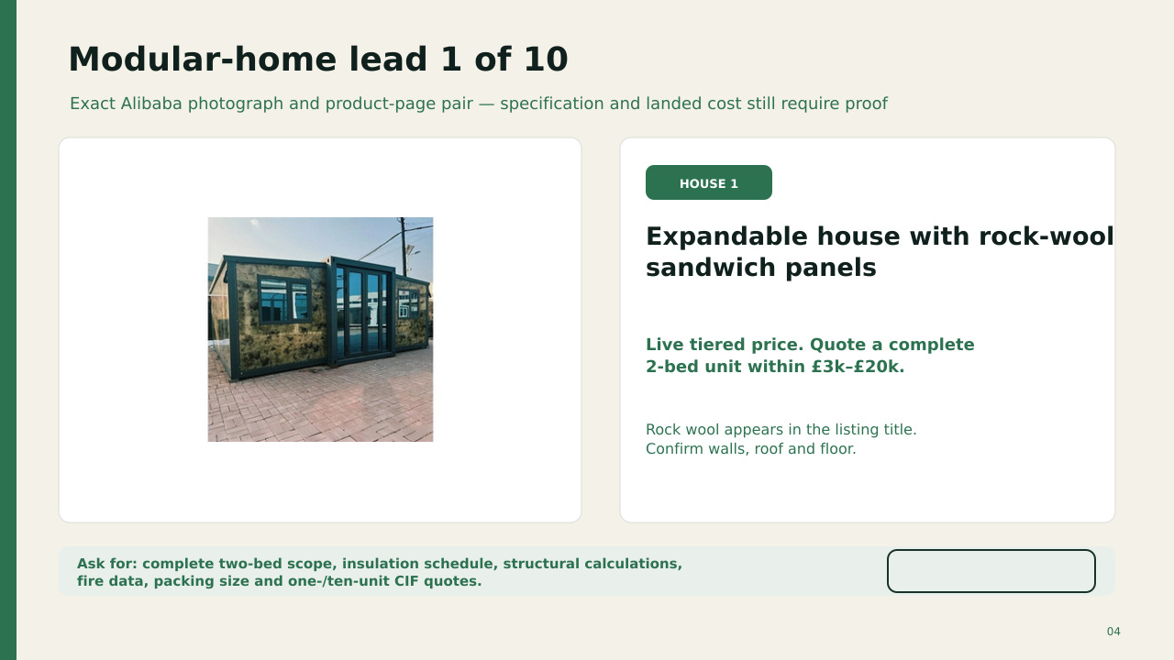
OPEN ALIBABA LISTING
MODEL PRICE £11,500
Seller tier hidden. Written quote required.
Rock wool appears in the title. The £11,500 figure is a planning allowance for comparison, not a seller quote.
QTY | BUY DISC. | SHIP + UK / UNIT | LANDED / UNIT | ORDER TOTAL | SUPPLY
1 | 0% | £9.0k | £24.6k | £24.6k | 8–14 wk
10 | 5% | £6.5k | £20.9k | £209k | 3–5 mo
100 | 12% | £5.2k | £18.4k | £1.84m | 6–12 mo
1,000 | 18% | £4.6k | £16.8k | £16.84m | 1–3 yr
1m | 25% | £4.0k | £15.2k | £15.2bn | 10+ yr
Model: factory price after shown buying discount + estimated ocean freight, insurance, port, UK haulage and crane; then 20% import VAT. Duty assumed 0%. Excludes land, approvals, base, utilities and installation. Deploy 1–5 working days per unit after the prepared site is ready.
OPEN ALIBABA LISTING
Notes:
The OPEN ALIBABA LISTING label links to this exact product page. The Alibaba-hosted photograph was matched through indexed image results on 12 September 2026. Listing content can change or disappear.
Sources checked 12 September 2026:
https://www.alibaba.com/product-detail/High-Quality-Expandable-Container-House-Rock_1601761827603.html
https://s.alicdn.com/@sc04/kf/H6ccee1ebfe3942a0911de36a7df819del.jpg_960x960q80.jpg
Pricing and scale model added 12 September 2026.
FX planning rate: US$1.35 per £1.
Buying discounts and freight reductions are scenario assumptions, not supplier quotations.
Import VAT basis: https://www.gov.uk/goods-sent-from-abroad/tax-and-duty
Freight volatility reference: https://www.freightos.com/shipping-routes/shipping-from-china-to-the-uk/
Current Alibaba market benchmark page: https://www.alibaba.com/countrysearch/CN/home-and-house.html
Exact product link: https://www.alibaba.com/product-detail/High-Quality-Expandable-Container-House-Rock_1601761827603.html

Slide 5
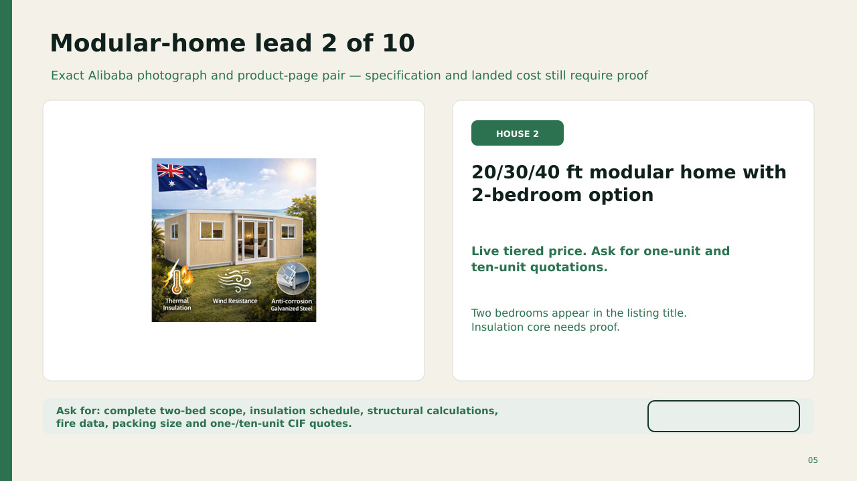
OPEN ALIBABA LISTING
MODEL PRICE £8,000
Seller tier hidden. Written quote required.
The listing names a two-bedroom option. The cost model assumes a mid-range fitted configuration.
QTY | BUY DISC. | SHIP + UK / UNIT | LANDED / UNIT | ORDER TOTAL | SUPPLY
1 | 0% | £9.0k | £20.4k | £20.4k | 8–14 wk
10 | 5% | £6.5k | £16.9k | £169k | 3–5 mo
100 | 12% | £5.2k | £14.7k | £1.47m | 6–12 mo
1,000 | 18% | £4.6k | £13.4k | £13.39m | 1–3 yr
1m | 25% | £4.0k | £12.0k | £12.0bn | 10+ yr
Model: factory price after shown buying discount + estimated ocean freight, insurance, port, UK haulage and crane; then 20% import VAT. Duty assumed 0%. Excludes land, approvals, base, utilities and installation. Deploy 1–5 working days per unit after the prepared site is ready.
OPEN ALIBABA LISTING
Notes:
The OPEN ALIBABA LISTING label links to this exact product page. The Alibaba-hosted photograph was matched through indexed image results on 12 September 2026. Listing content can change or disappear.
Sources checked 12 September 2026:
https://www.alibaba.com/product-detail/Luxury-Prefab-20ft-30ft-40ft-Shipping_1601692791934.html
https://s.alicdn.com/@sc04/kf/H9a2a601f82534598a5518d209ec7c380f.png_960x960q80.jpg
Pricing and scale model added 12 September 2026.
FX planning rate: US$1.35 per £1.
Buying discounts and freight reductions are scenario assumptions, not supplier quotations.
Import VAT basis: https://www.gov.uk/goods-sent-from-abroad/tax-and-duty
Freight volatility reference: https://www.freightos.com/shipping-routes/shipping-from-china-to-the-uk/
Current Alibaba market benchmark page: https://www.alibaba.com/countrysearch/CN/home-and-house.html
Exact product link: https://www.alibaba.com/product-detail/Luxury-Prefab-20ft-30ft-40ft-Shipping_1601692791934.html

Slide 6
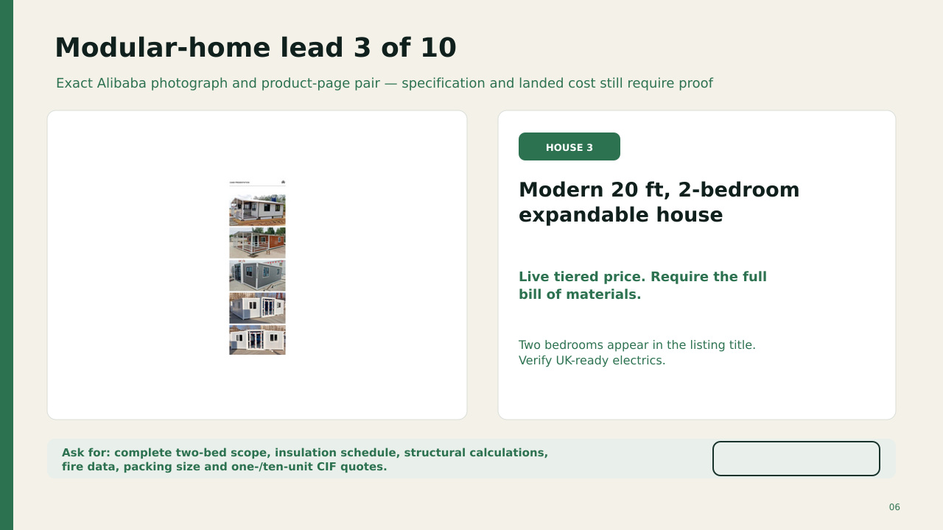
OPEN ALIBABA LISTING
MODEL PRICE £4,000
Seller tier hidden. Written quote required.
The listing names two bedrooms. Confirm insulation, kitchen, bathroom and UK-ready services in the signed specification.
QTY | BUY DISC. | SHIP + UK / UNIT | LANDED / UNIT | ORDER TOTAL | SUPPLY
1 | 0% | £9.0k | £15.6k | £15.6k | 8–14 wk
10 | 5% | £6.5k | £12.4k | £124k | 3–5 mo
100 | 12% | £5.2k | £10.5k | £1.05m | 6–12 mo
1,000 | 18% | £4.6k | £9.5k | £9.46m | 1–3 yr
1m | 25% | £4.0k | £8.4k | £8.40bn | 10+ yr
Model: factory price after shown buying discount + estimated ocean freight, insurance, port, UK haulage and crane; then 20% import VAT. Duty assumed 0%. Excludes land, approvals, base, utilities and installation. Deploy 1–5 working days per unit after the prepared site is ready.
OPEN ALIBABA LISTING
Notes:
The OPEN ALIBABA LISTING label links to this exact product page. The Alibaba-hosted photograph was matched through indexed image results on 12 September 2026. Listing content can change or disappear.
Sources checked 12 September 2026:
https://www.alibaba.com/product-detail/Modern-20ft-2-Bedroom-Expandable-Container_1601379409859.html
https://sc04.alicdn.com/kf/H0ff9518bed5b4041bd4a2f16abd6b345z/284471129/H0ff9518bed5b4041bd4a2f16abd6b345z.png
Pricing and scale model added 12 September 2026.
FX planning rate: US$1.35 per £1.
Buying discounts and freight reductions are scenario assumptions, not supplier quotations.
Import VAT basis: https://www.gov.uk/goods-sent-from-abroad/tax-and-duty
Freight volatility reference: https://www.freightos.com/shipping-routes/shipping-from-china-to-the-uk/
Current Alibaba market benchmark page: https://www.alibaba.com/countrysearch/CN/home-and-house.html
Exact product link: https://www.alibaba.com/product-detail/Modern-20ft-2-Bedroom-Expandable-Container_1601379409859.html

Slide 7
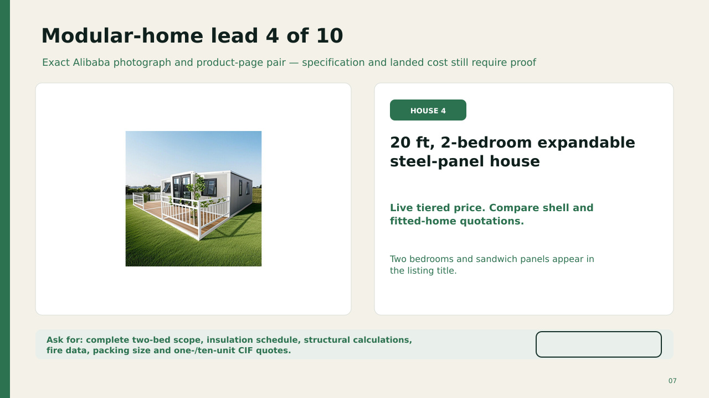
OPEN ALIBABA LISTING
PUBLIC MATCH £2,888–£3,407
Matching public offer: US$3,899–4,599.
A matching-title public offer shows US$3,899–4,599. Confirm that the exact Alibaba seller offers the pictured specification.
QTY | BUY DISC. | SHIP + UK / UNIT | LANDED / UNIT | ORDER TOTAL | SUPPLY
1 | 0% | £9.0k | £14.6k | £14.6k | 8–14 wk
10 | 5% | £6.5k | £11.4k | £114k | 3–5 mo
100 | 12% | £5.2k | £9.6k | £957k | 6–12 mo
1,000 | 18% | £4.6k | £8.6k | £8.62m | 1–3 yr
1m | 25% | £4.0k | £7.6k | £7.63bn | 10+ yr
Model: factory price after shown buying discount + estimated ocean freight, insurance, port, UK haulage and crane; then 20% import VAT. Duty assumed 0%. Excludes land, approvals, base, utilities and installation. Deploy 1–5 working days per unit after the prepared site is ready.
OPEN ALIBABA LISTING
Notes:
The OPEN ALIBABA LISTING label links to this exact product page. The Alibaba-hosted photograph was matched through indexed image results on 12 September 2026. Listing content can change or disappear.
Sources checked 12 September 2026:
https://www.alibaba.com/product-detail/20Ft-2-Bedroom-Prefab-House-Expandable_1601368817725.html
https://s.alicdn.com/@sc04/kf/H119ea88345f543c4a437f511f7803510J.png_960x960q80.jpg
Pricing and scale model added 12 September 2026.
FX planning rate: US$1.35 per £1.
Buying discounts and freight reductions are scenario assumptions, not supplier quotations.
Import VAT basis: https://www.gov.uk/goods-sent-from-abroad/tax-and-duty
Freight volatility reference: https://www.freightos.com/shipping-routes/shipping-from-china-to-the-uk/
Current Alibaba market benchmark page: https://www.alibaba.com/countrysearch/CN/home-and-house.html
Exact product link: https://www.alibaba.com/product-detail/20Ft-2-Bedroom-Prefab-House-Expandable_1601368817725.html

Slide 8
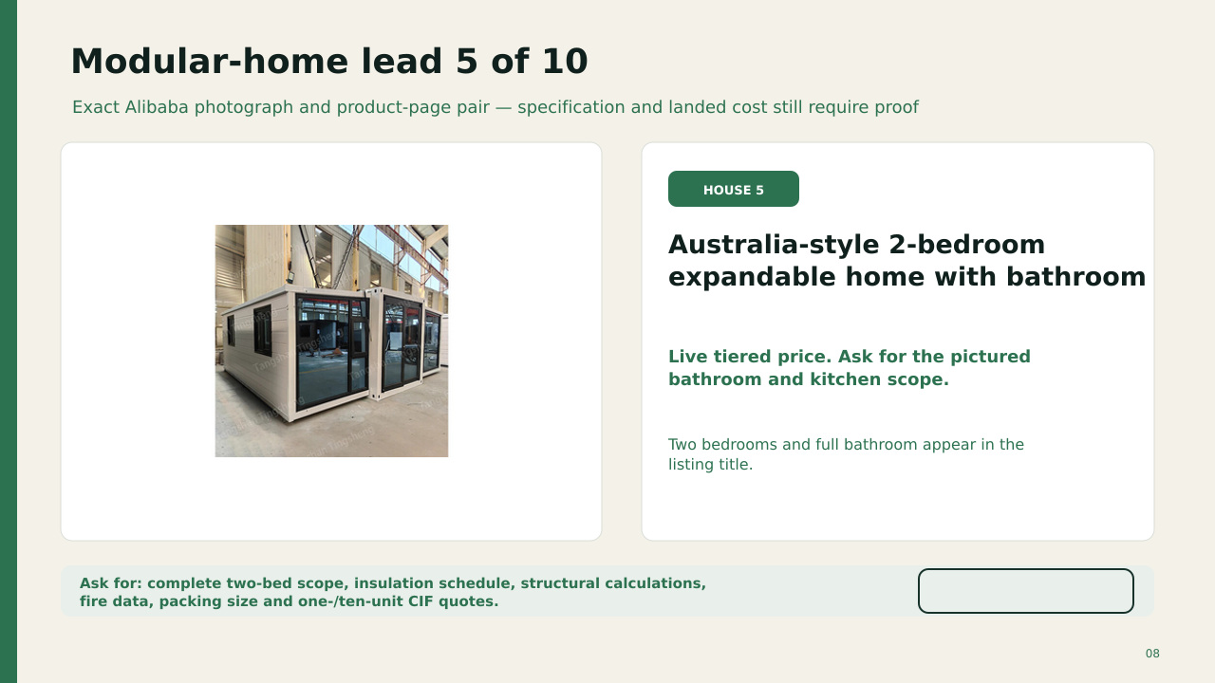
OPEN ALIBABA LISTING
MODEL PRICE £6,500
Seller tier hidden. Written quote required.
The listing names a bathroom. The model allows more than a bare shell but excludes UK site connections.
QTY | BUY DISC. | SHIP + UK / UNIT | LANDED / UNIT | ORDER TOTAL | SUPPLY
1 | 0% | £9.0k | £18.6k | £18.6k | 8–14 wk
10 | 5% | £6.5k | £15.2k | £152k | 3–5 mo
100 | 12% | £5.2k | £13.1k | £1.31m | 6–12 mo
1,000 | 18% | £4.6k | £11.9k | £11.92m | 1–3 yr
1m | 25% | £4.0k | £10.7k | £10.7bn | 10+ yr
Model: factory price after shown buying discount + estimated ocean freight, insurance, port, UK haulage and crane; then 20% import VAT. Duty assumed 0%. Excludes land, approvals, base, utilities and installation. Deploy 1–5 working days per unit after the prepared site is ready.
OPEN ALIBABA LISTING
Notes:
The OPEN ALIBABA LISTING label links to this exact product page. The Alibaba-hosted photograph was matched through indexed image results on 12 September 2026. Listing content can change or disappear.
Sources checked 12 September 2026:
https://www.alibaba.com/product-detail/20Ft-Australia-2-Bedroom-Prefabricated-Container_1601223042436.html
https://sc04.alicdn.com/kf/Hae64345d6d3f4d3aa784d3a6ffae69b2o/20Ft-Australia-2-Bedroom-Prefabricated-Container-Home-40Ft-Expandable-Container-House-With-Full-Bathroom.jpg
Pricing and scale model added 12 September 2026.
FX planning rate: US$1.35 per £1.
Buying discounts and freight reductions are scenario assumptions, not supplier quotations.
Import VAT basis: https://www.gov.uk/goods-sent-from-abroad/tax-and-duty
Freight volatility reference: https://www.freightos.com/shipping-routes/shipping-from-china-to-the-uk/
Current Alibaba market benchmark page: https://www.alibaba.com/countrysearch/CN/home-and-house.html
Exact product link: https://www.alibaba.com/product-detail/20Ft-Australia-2-Bedroom-Prefabricated-Container_1601223042436.html

Slide 9
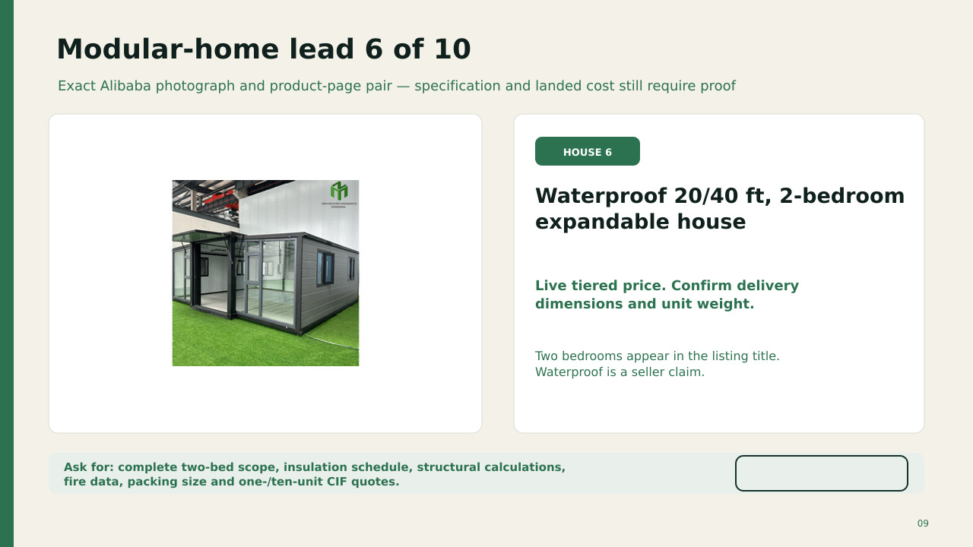
OPEN ALIBABA LISTING
MODEL PRICE £6,000
Seller tier hidden. Written quote required.
Waterproof and two-bedroom claims need drawings and test evidence. The price shown here is a comparison allowance.
QTY | BUY DISC. | SHIP + UK / UNIT | LANDED / UNIT | ORDER TOTAL | SUPPLY
1 | 0% | £9.0k | £18.0k | £18.0k | 8–14 wk
10 | 5% | £6.5k | £14.6k | £146k | 3–5 mo
100 | 12% | £5.2k | £12.6k | £1.26m | 6–12 mo
1,000 | 18% | £4.6k | £11.4k | £11.42m | 1–3 yr
1m | 25% | £4.0k | £10.2k | £10.2bn | 10+ yr
Model: factory price after shown buying discount + estimated ocean freight, insurance, port, UK haulage and crane; then 20% import VAT. Duty assumed 0%. Excludes land, approvals, base, utilities and installation. Deploy 1–5 working days per unit after the prepared site is ready.
OPEN ALIBABA LISTING
Notes:
The OPEN ALIBABA LISTING label links to this exact product page. The Alibaba-hosted photograph was matched through indexed image results on 12 September 2026. Listing content can change or disappear.
Sources checked 12 September 2026:
https://www.alibaba.com/product-detail/20ft-40ft-Waterproof-Prefabricated-Luxury-Foldable_1601292783708.html
https://s.alicdn.com/@sc04/kf/H3c2c18f257a244cbb5cbb01c574c6a89L.jpg_960x960q80.jpg
Pricing and scale model added 12 September 2026.
FX planning rate: US$1.35 per £1.
Buying discounts and freight reductions are scenario assumptions, not supplier quotations.
Import VAT basis: https://www.gov.uk/goods-sent-from-abroad/tax-and-duty
Freight volatility reference: https://www.freightos.com/shipping-routes/shipping-from-china-to-the-uk/
Current Alibaba market benchmark page: https://www.alibaba.com/countrysearch/CN/home-and-house.html
Exact product link: https://www.alibaba.com/product-detail/20ft-40ft-Waterproof-Prefabricated-Luxury-Foldable_1601292783708.html

Slide 10
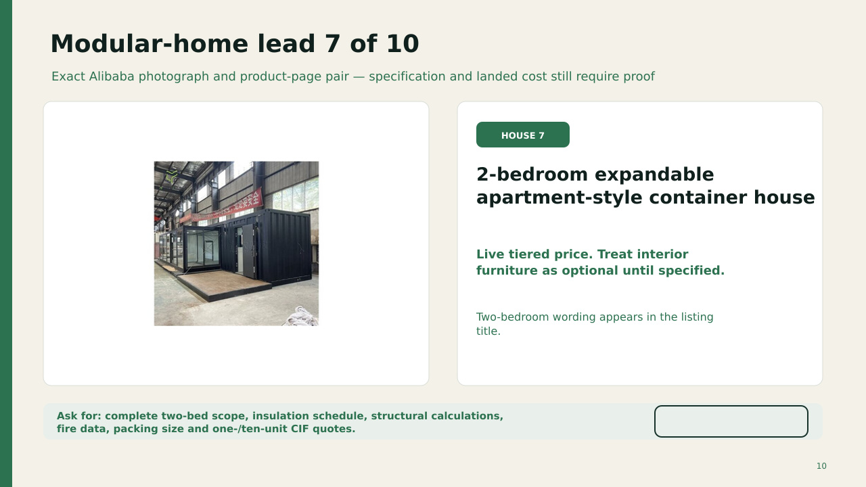
OPEN ALIBABA LISTING
MODEL PRICE £5,500
Seller tier hidden. Written quote required.
Furniture and fitted systems may be optional. Treat the model price as a procurement placeholder.
QTY | BUY DISC. | SHIP + UK / UNIT | LANDED / UNIT | ORDER TOTAL | SUPPLY
1 | 0% | £9.0k | £17.4k | £17.4k | 8–14 wk
10 | 5% | £6.5k | £14.1k | £141k | 3–5 mo
100 | 12% | £5.2k | £12.0k | £1.20m | 6–12 mo
1,000 | 18% | £4.6k | £10.9k | £10.93m | 1–3 yr
1m | 25% | £4.0k | £9.8k | £9.75bn | 10+ yr
Model: factory price after shown buying discount + estimated ocean freight, insurance, port, UK haulage and crane; then 20% import VAT. Duty assumed 0%. Excludes land, approvals, base, utilities and installation. Deploy 1–5 working days per unit after the prepared site is ready.
OPEN ALIBABA LISTING
Notes:
The OPEN ALIBABA LISTING label links to this exact product page. The Alibaba-hosted photograph was matched through indexed image results on 12 September 2026. Listing content can change or disappear.
Sources checked 12 September 2026:
https://www.alibaba.com/product-detail/2-bedroom-container-house-expandable-container_1601153445453.html
https://sc04.alicdn.com/kf/H5c2ddfc62d384e5aa0a52818f0c86d69U/232076667/H5c2ddfc62d384e5aa0a52818f0c86d69U.png
Pricing and scale model added 12 September 2026.
FX planning rate: US$1.35 per £1.
Buying discounts and freight reductions are scenario assumptions, not supplier quotations.
Import VAT basis: https://www.gov.uk/goods-sent-from-abroad/tax-and-duty
Freight volatility reference: https://www.freightos.com/shipping-routes/shipping-from-china-to-the-uk/
Current Alibaba market benchmark page: https://www.alibaba.com/countrysearch/CN/home-and-house.html
Exact product link: https://www.alibaba.com/product-detail/2-bedroom-container-house-expandable-container_1601153445453.html

Slide 11
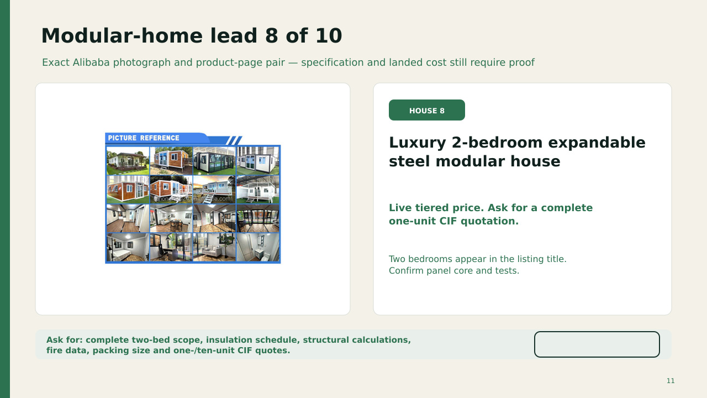
OPEN ALIBABA LISTING
MODEL PRICE £9,000
Seller tier hidden. Written quote required.
The listing names a luxury two-bedroom form. Fire and insulation evidence still need written confirmation.
QTY | BUY DISC. | SHIP + UK / UNIT | LANDED / UNIT | ORDER TOTAL | SUPPLY
1 | 0% | £9.0k | £21.6k | £21.6k | 8–14 wk
10 | 5% | £6.5k | £18.1k | £181k | 3–5 mo
100 | 12% | £5.2k | £15.7k | £1.57m | 6–12 mo
1,000 | 18% | £4.6k | £14.4k | £14.38m | 1–3 yr
1m | 25% | £4.0k | £12.9k | £12.9bn | 10+ yr
Model: factory price after shown buying discount + estimated ocean freight, insurance, port, UK haulage and crane; then 20% import VAT. Duty assumed 0%. Excludes land, approvals, base, utilities and installation. Deploy 1–5 working days per unit after the prepared site is ready.
OPEN ALIBABA LISTING
Notes:
The OPEN ALIBABA LISTING label links to this exact product page. The Alibaba-hosted photograph was matched through indexed image results on 12 September 2026. Listing content can change or disappear.
Sources checked 12 September 2026:
https://www.alibaba.com/product-detail/2-Bedroom-Luxury-Modular-Prefab-Steel_1601484565687.html
https://s.alicdn.com/@sc04/kf/Hcb6e2c109705470fad656ec9408f839co.jpg_960x960q80.jpg
Pricing and scale model added 12 September 2026.
FX planning rate: US$1.35 per £1.
Buying discounts and freight reductions are scenario assumptions, not supplier quotations.
Import VAT basis: https://www.gov.uk/goods-sent-from-abroad/tax-and-duty
Freight volatility reference: https://www.freightos.com/shipping-routes/shipping-from-china-to-the-uk/
Current Alibaba market benchmark page: https://www.alibaba.com/countrysearch/CN/home-and-house.html
Exact product link: https://www.alibaba.com/product-detail/2-Bedroom-Luxury-Modular-Prefab-Steel_1601484565687.html

Slide 12
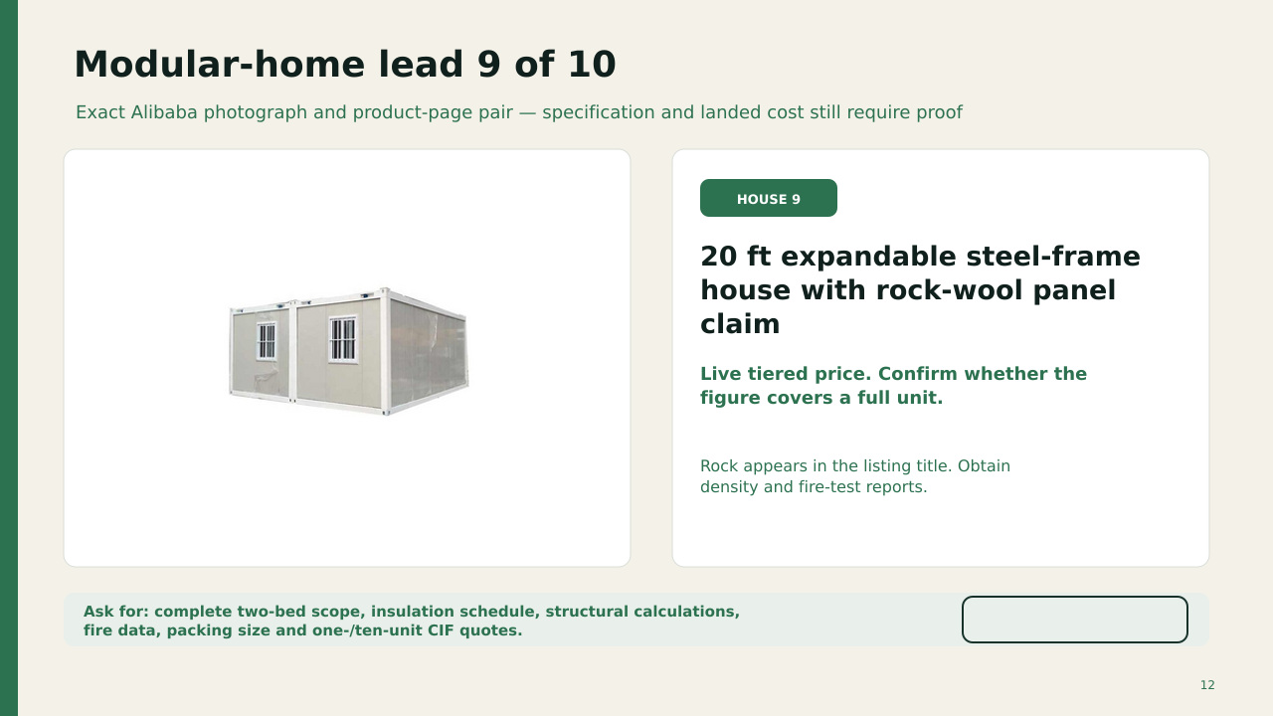
OPEN ALIBABA LISTING
MODEL PRICE £7,000
Seller tier hidden. Written quote required.
Rock wool appears in the title. Confirm thickness and coverage in walls, roof and floor before deposit.
QTY | BUY DISC. | SHIP + UK / UNIT | LANDED / UNIT | ORDER TOTAL | SUPPLY
1 | 0% | £9.0k | £19.2k | £19.2k | 8–14 wk
10 | 5% | £6.5k | £15.8k | £158k | 3–5 mo
100 | 12% | £5.2k | £13.6k | £1.36m | 6–12 mo
1,000 | 18% | £4.6k | £12.4k | £12.41m | 1–3 yr
1m | 25% | £4.0k | £11.1k | £11.1bn | 10+ yr
Model: factory price after shown buying discount + estimated ocean freight, insurance, port, UK haulage and crane; then 20% import VAT. Duty assumed 0%. Excludes land, approvals, base, utilities and installation. Deploy 1–5 working days per unit after the prepared site is ready.
OPEN ALIBABA LISTING
Notes:
The OPEN ALIBABA LISTING label links to this exact product page. The Alibaba-hosted photograph was matched through indexed image results on 12 September 2026. Listing content can change or disappear.
Sources checked 12 September 2026:
https://www.alibaba.com/product-detail/20ft-Expandable-Container-House-Prefabricated-Steel_1600192564773.html
https://s.alicdn.com/@sc04/kf/Hc227d9e9c69a4eeea18153ffb25e85d95.jpg_720x720q50.jpg
Pricing and scale model added 12 September 2026.
FX planning rate: US$1.35 per £1.
Buying discounts and freight reductions are scenario assumptions, not supplier quotations.
Import VAT basis: https://www.gov.uk/goods-sent-from-abroad/tax-and-duty
Freight volatility reference: https://www.freightos.com/shipping-routes/shipping-from-china-to-the-uk/
Current Alibaba market benchmark page: https://www.alibaba.com/countrysearch/CN/home-and-house.html
Exact product link: https://www.alibaba.com/product-detail/20ft-Expandable-Container-House-Prefabricated-Steel_1600192564773.html

Slide 13
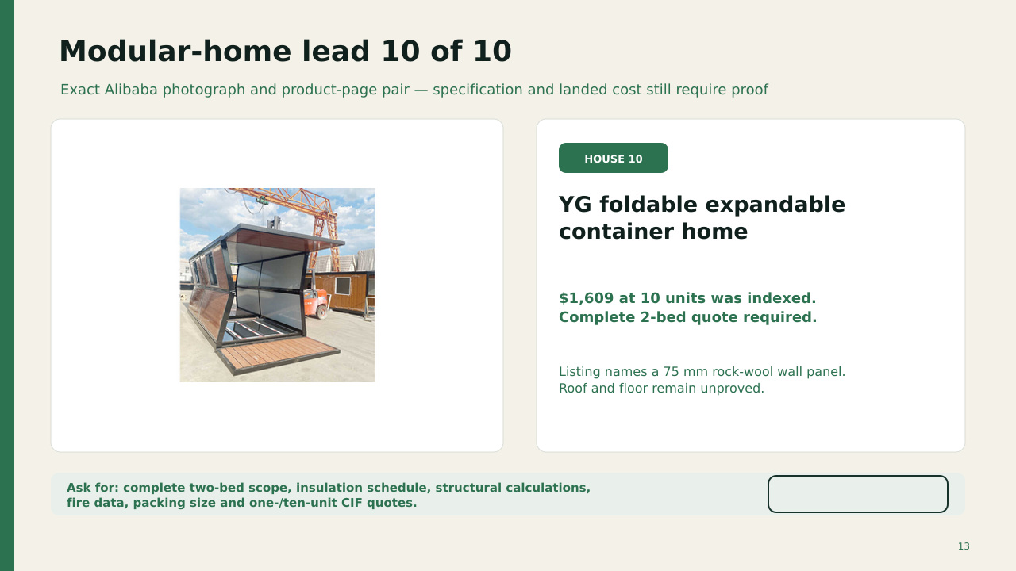
OPEN ALIBABA LISTING
INDEXED PRICE £1,192 @ 10
US$1,609 at 10 units was indexed.
The indexed figure may cover a shell or limited configuration. It does not prove a complete two-bedroom home.
QTY | BUY DISC. | SHIP + UK / UNIT | LANDED / UNIT | ORDER TOTAL | SUPPLY
1 | 0% | £9.0k | £12.2k | £12.2k | 8–14 wk
10 | 5% | £6.5k | £9.2k | £91.6k | 3–5 mo
100 | 12% | £5.2k | £7.5k | £750k | 6–12 mo
1,000 | 18% | £4.6k | £6.7k | £6.69m | 1–3 yr
1m | 25% | £4.0k | £5.9k | £5.87bn | 10+ yr
Model: factory price after shown buying discount + estimated ocean freight, insurance, port, UK haulage and crane; then 20% import VAT. Duty assumed 0%. Excludes land, approvals, base, utilities and installation. Deploy 1–5 working days per unit after the prepared site is ready.
OPEN ALIBABA LISTING
Notes:
The OPEN ALIBABA LISTING label links to this exact product page. The Alibaba-hosted photograph was matched through indexed image results on 12 September 2026. Listing content can change or disappear.
Sources checked 12 September 2026:
https://www.alibaba.com/product-detail/YG-Prefabricated-Luxury-Living-Expandable-Container_1601214491407.html
https://s.alicdn.com/@sc04/kf/H323c9b90ebe0409f9089094e9a2b594aN.jpg_720x720q50.jpg
Pricing and scale model added 12 September 2026.
FX planning rate: US$1.35 per £1.
Buying discounts and freight reductions are scenario assumptions, not supplier quotations.
Import VAT basis: https://www.gov.uk/goods-sent-from-abroad/tax-and-duty
Freight volatility reference: https://www.freightos.com/shipping-routes/shipping-from-china-to-the-uk/
Current Alibaba market benchmark page: https://www.alibaba.com/countrysearch/CN/home-and-house.html
Exact product link: https://www.alibaba.com/product-detail/YG-Prefabricated-Luxury-Living-Expandable-Container_1601214491407.html

Slide 14
Three pictured listings name rock wool, but only one gives a thickness
A written construction schedule must turn a marketing phrase into a testable specification
VISIBLE EVIDENCE
Envelope
Walls, roof and floor all named
YG names a 75 mm rock-wool wall panel
Material
Manufacturer, density and thickness
Thermal
Calculated U-values for the exact assembly
That still does not prove rock wool in the roof or floor, the required U-value, fire performance, moisture control or UK compliance.
Fire
Test reports for panels, joints and penetrations
Moisture
Vapour control, thermal bridges and condensation
Acoustic
Measured airborne and impact performance
Building Control should agree the evidence route before manufacture begins.
14
Notes:
The Approved Document B FAQ specifically warns that volumetric modular construction may need detailed evidence agreed with the building control body.
Sources checked 12 September 2026:
https://www.alibaba.com/product-detail/YG-Prefabricated-Luxury-Living-Expandable-Container_1601214491407.html
https://www.gov.uk/government/publications/approved-document-l-2026
https://www.gov.uk/guidance/approved-document-b-fire-safety-frequently-asked-questions

Slide 15
A full concrete slab can be avoided, but foundations cannot
The ground system must carry weight, resist wind uplift, drain water and remain level
Engineered hardstanding
Ground screws or piles
Piers or stilts
Compacted sub-base with drainage and adjustable steel pads
Steel supports can reduce excavation and remain removable
Useful on slopes or flood-aware sites when an engineer designs the bracing
Before ordering: soil and drainage review, bearing capacity, wind zone and uplift, flood risk, service routes, delivery access and crane position.
15
Notes:
Foundation concepts are illustrative. A UK structural engineer must design the support system for the exact unit and site.
Sources checked 12 September 2026:
https://www.gov.uk/planning-permission-england-wales
https://www.gov.uk/building-regulations-approval

Slide 16
A £10,000 factory house can reach about £22,000 before site works
Illustrative procurement case. Real duty, freight and handling depend on the contract and commodity code
Factory configuration
£10,000
Freight and insurance
£5,000
Import VAT illustration
£3,000
Port, UK haulage and crane
£4,000
About £22,000 before planning, design, Building Control, foundations, utility connections, drainage, landscaping and contingency
VAT normally applies to the customs value including postage, packaging, insurance and any duty. Check the tariff classification before relying on an estimate.
16
Notes:
The duty line is shown as zero only for this arithmetic example. It is not a statement of the correct commodity code or rate.
Sources checked 12 September 2026:
https://www.gov.uk/import-goods-into-uk
https://www.gov.uk/goods-sent-from-abroad/tax-and-duty
https://www.gov.uk/trade-tariff

Slide 17
Low-cost electric transport serves different jobs
The cheapest listing may be useful on private land even when it cannot qualify for public-road use
Short local trips
Accessible mobility
Family and shared use
Work and delivery
Two-seat L6e-style cabin cars
Enclosed scooters and low-speed cabins
Three-seat and four-seat mini EVs
Open cargo trikes, pickups and refrigerated boxes
Public-road use requires the exact vehicle, documents and equipment to pass the GB approval and registration route.
17
Notes:
Sources checked 12 September 2026:
https://autopart.alibaba.com/product/cheapest-cars
https://autopart.alibaba.com/product/3-wheel-electric-cars
https://www.gov.uk/vehicle-approval/motorcycle-single-vehicle-approval

Slide 18
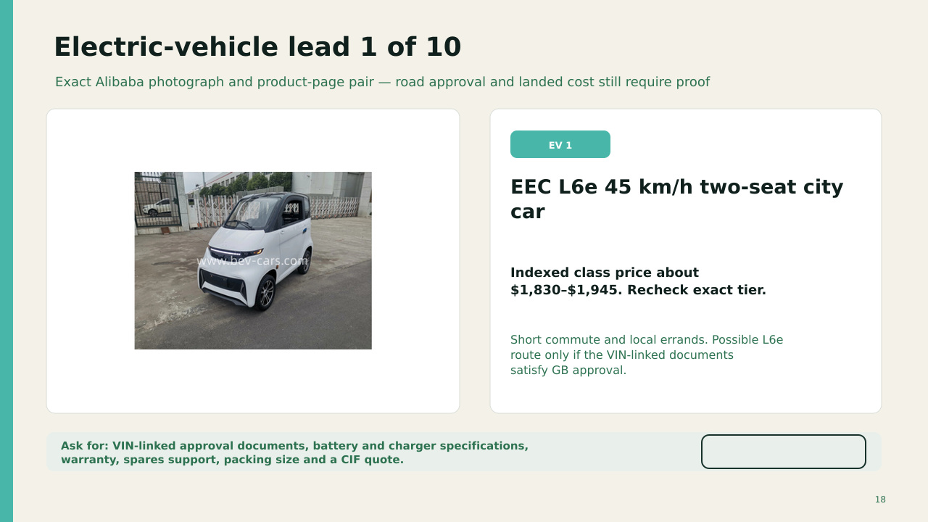
OPEN ALIBABA LISTING
INDEXED PRICE £1,356–£1,441
US$1,830–1,945 indexed.
Possible L6e route only if the VIN-linked documents and exact equipment support GB approval.
QTY | BUY DISC. | SHIP + UK / UNIT | LANDED / UNIT | ORDER TOTAL | SUPPLY
1 | 0% | £2.0k | £4.5k | £4.5k | 8–14 wk
10 | 5% | £1.0k | £3.1k | £30.7k | 10–18 wk
100 | 12% | £750 | £2.6k | £261k | 4–8 mo
1,000 | 18% | £650 | £2.4k | £2.37m | 1–2 yr
1m | 25% | £500 | £2.0k | £2.04bn | 5–10+ yr
Model: factory price after shown buying discount + estimated freight and UK delivery; then a cautious 10% duty allowance and 20% import VAT. Excludes testing, modification, DVLA, plates and insurance. Commission 0.5–2 days; GB road approval can take longer or fail.
OPEN ALIBABA LISTING
Notes:
The OPEN ALIBABA LISTING label links to this exact product page. The Alibaba-hosted photograph was matched through indexed image results on 12 September 2026. Listing content can change or disappear.
Sources checked 12 September 2026:
https://www.alibaba.com/product-detail/EEC-L6e-electric-city-car-45Km_1600877218700.html
https://sc04.alicdn.com/kf/H446784bc201d46fd9e2d08fe43bac4a9S/251112827/H446784bc201d46fd9e2d08fe43bac4a9S.jpg
Pricing and scale model added 12 September 2026.
FX planning rate: US$1.35 per £1.
Buying discounts and freight reductions are scenario assumptions, not supplier quotations.
Import VAT basis: https://www.gov.uk/goods-sent-from-abroad/tax-and-duty
Freight volatility reference: https://www.freightos.com/shipping-routes/shipping-from-china-to-the-uk/
Current Alibaba market benchmark page: https://www.alibaba.com/countrysearch/CN/home-and-house.html
Exact product link: https://www.alibaba.com/product-detail/EEC-L6e-electric-city-car-45Km_1600877218700.html

Slide 19
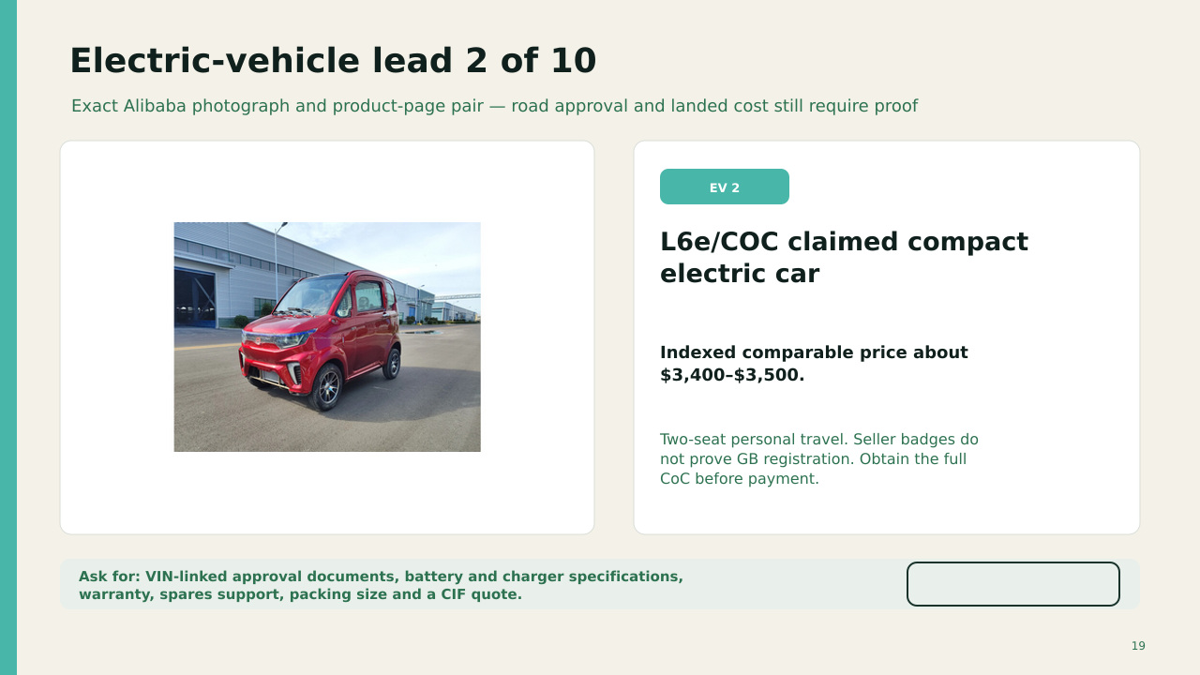
OPEN ALIBABA LISTING
INDEXED PRICE £2,519–£2,593
US$3,400–3,500 indexed.
EEC or CoC wording from a seller does not guarantee DVLA registration or an insurance quote.
QTY | BUY DISC. | SHIP + UK / UNIT | LANDED / UNIT | ORDER TOTAL | SUPPLY
1 | 0% | £2.0k | £6.0k | £6.0k | 8–14 wk
10 | 5% | £1.0k | £4.5k | £45.3k | 10–18 wk
100 | 12% | £750 | £4.0k | £396k | 4–8 mo
1,000 | 18% | £650 | £3.6k | £3.62m | 1–2 yr
1m | 25% | £500 | £3.2k | £3.19bn | 5–10+ yr
Model: factory price after shown buying discount + estimated freight and UK delivery; then a cautious 10% duty allowance and 20% import VAT. Excludes testing, modification, DVLA, plates and insurance. Commission 0.5–2 days; GB road approval can take longer or fail.
OPEN ALIBABA LISTING
Notes:
The OPEN ALIBABA LISTING label links to this exact product page. The Alibaba-hosted photograph was matched through indexed image results on 12 September 2026. Listing content can change or disappear.
Sources checked 12 September 2026:
https://www.alibaba.com/product-detail/electric-cars-approved-eec-coc-l6e_1601048450320.html
https://sc04.alicdn.com/kf/A875b30c2891b40249aa948138fd2a641Q/251112827/A875b30c2891b40249aa948138fd2a641Q.jpg
Pricing and scale model added 12 September 2026.
FX planning rate: US$1.35 per £1.
Buying discounts and freight reductions are scenario assumptions, not supplier quotations.
Import VAT basis: https://www.gov.uk/goods-sent-from-abroad/tax-and-duty
Freight volatility reference: https://www.freightos.com/shipping-routes/shipping-from-china-to-the-uk/
Current Alibaba market benchmark page: https://www.alibaba.com/countrysearch/CN/home-and-house.html
Exact product link: https://www.alibaba.com/product-detail/electric-cars-approved-eec-coc-l6e_1601048450320.html

Slide 20
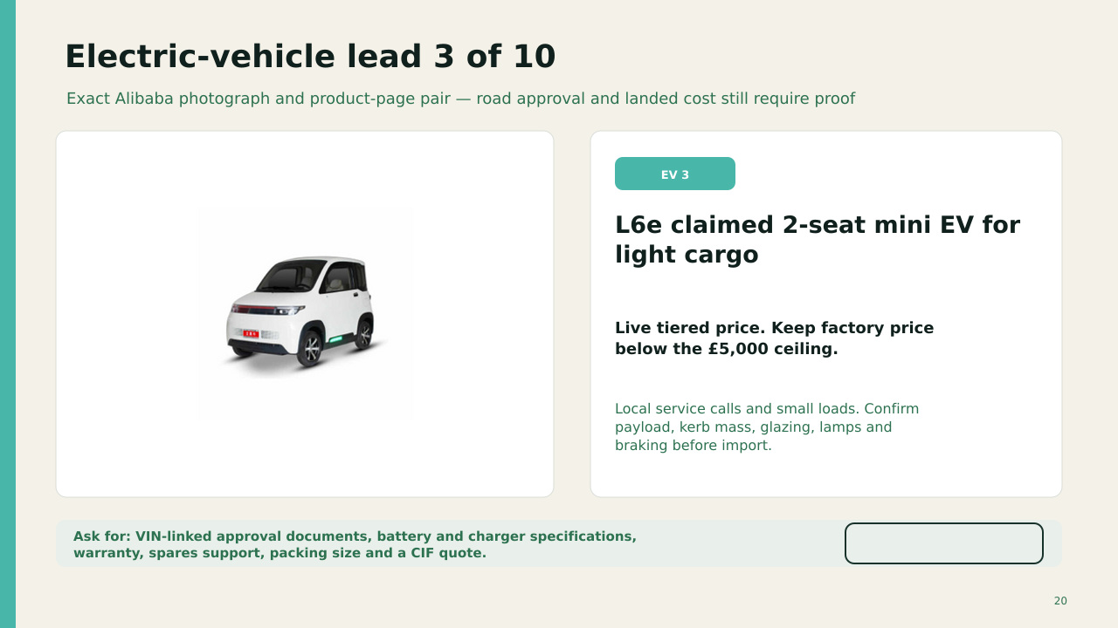
OPEN ALIBABA LISTING
MODEL PRICE £3,500
Seller tier hidden. Written quote required.
The model stays below the £5,000 factory-price ceiling. Confirm battery, charger, brakes, glazing and lighting.
QTY | BUY DISC. | SHIP + UK / UNIT | LANDED / UNIT | ORDER TOTAL | SUPPLY
1 | 0% | £2.0k | £7.3k | £7.3k | 8–14 wk
10 | 5% | £1.0k | £5.7k | £57.1k | 10–18 wk
100 | 12% | £750 | £5.1k | £506k | 4–8 mo
1,000 | 18% | £650 | £4.6k | £4.65m | 1–2 yr
1m | 25% | £500 | £4.1k | £4.13bn | 5–10+ yr
Model: factory price after shown buying discount + estimated freight and UK delivery; then a cautious 10% duty allowance and 20% import VAT. Excludes testing, modification, DVLA, plates and insurance. Commission 0.5–2 days; GB road approval can take longer or fail.
OPEN ALIBABA LISTING
Notes:
The OPEN ALIBABA LISTING label links to this exact product page. The Alibaba-hosted photograph was matched through indexed image results on 12 September 2026. Listing content can change or disappear.
Sources checked 12 September 2026:
https://www.alibaba.com/product-detail/EEC-L6e-Approved-Mini-2-Seater_1601214828459.html
https://s.alicdn.com/@sc04/kf/Hdaa505547baa4c45b0f8593b4003dfb1p.jpg_720x720q50.jpg
Pricing and scale model added 12 September 2026.
FX planning rate: US$1.35 per £1.
Buying discounts and freight reductions are scenario assumptions, not supplier quotations.
Import VAT basis: https://www.gov.uk/goods-sent-from-abroad/tax-and-duty
Freight volatility reference: https://www.freightos.com/shipping-routes/shipping-from-china-to-the-uk/
Current Alibaba market benchmark page: https://www.alibaba.com/countrysearch/CN/home-and-house.html
Exact product link: https://www.alibaba.com/product-detail/EEC-L6e-small-electric-car-for_1601214828459.html

Slide 21
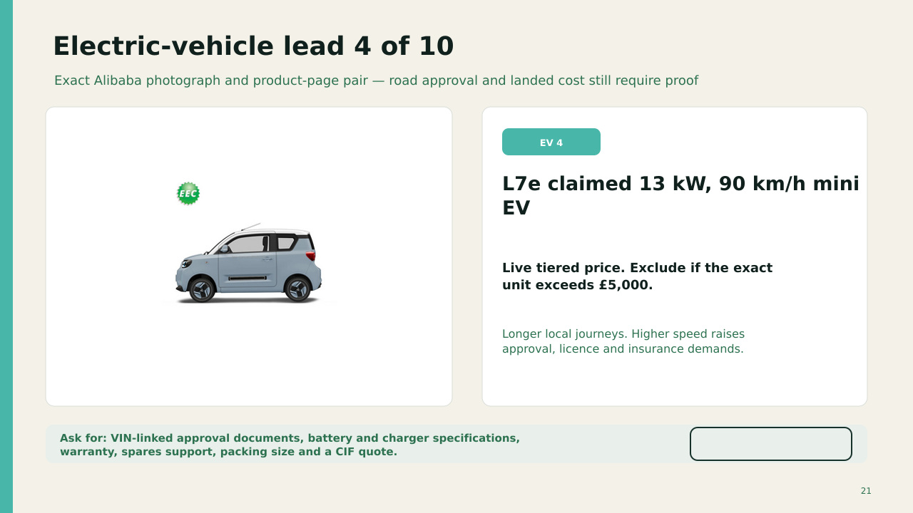
OPEN ALIBABA LISTING
MODEL PRICE £3,700
Seller tier hidden. Written quote required.
Higher speed raises approval, licensing and insurance demands. Reject the exact unit if the quote exceeds £5,000.
QTY | BUY DISC. | SHIP + UK / UNIT | LANDED / UNIT | ORDER TOTAL | SUPPLY
1 | 0% | £2.0k | £7.5k | £7.5k | 8–14 wk
10 | 5% | £1.0k | £6.0k | £59.6k | 10–18 wk
100 | 12% | £750 | £5.3k | £529k | 4–8 mo
1,000 | 18% | £650 | £4.9k | £4.86m | 1–2 yr
1m | 25% | £500 | £4.3k | £4.32bn | 5–10+ yr
Model: factory price after shown buying discount + estimated freight and UK delivery; then a cautious 10% duty allowance and 20% import VAT. Excludes testing, modification, DVLA, plates and insurance. Commission 0.5–2 days; GB road approval can take longer or fail.
OPEN ALIBABA LISTING
Notes:
The OPEN ALIBABA LISTING label links to this exact product page. The Alibaba-hosted photograph was matched through indexed image results on 12 September 2026. Listing content can change or disappear.
Sources checked 12 September 2026:
https://www.alibaba.com/product-detail/EEC-L7E-Approved-Four-wheel-13KW_1600761264020.html
https://sc04.alicdn.com/kf/Ad08aa323d7ec446490df7a57472655efv/251112827/Ad08aa323d7ec446490df7a57472655efv.jpg
Pricing and scale model added 12 September 2026.
FX planning rate: US$1.35 per £1.
Buying discounts and freight reductions are scenario assumptions, not supplier quotations.
Import VAT basis: https://www.gov.uk/goods-sent-from-abroad/tax-and-duty
Freight volatility reference: https://www.freightos.com/shipping-routes/shipping-from-china-to-the-uk/
Current Alibaba market benchmark page: https://www.alibaba.com/countrysearch/CN/home-and-house.html
Exact product link: https://www.alibaba.com/product-detail/EEC-L7e-13KW-90km-h-Mini_1600761264020.html

Slide 22
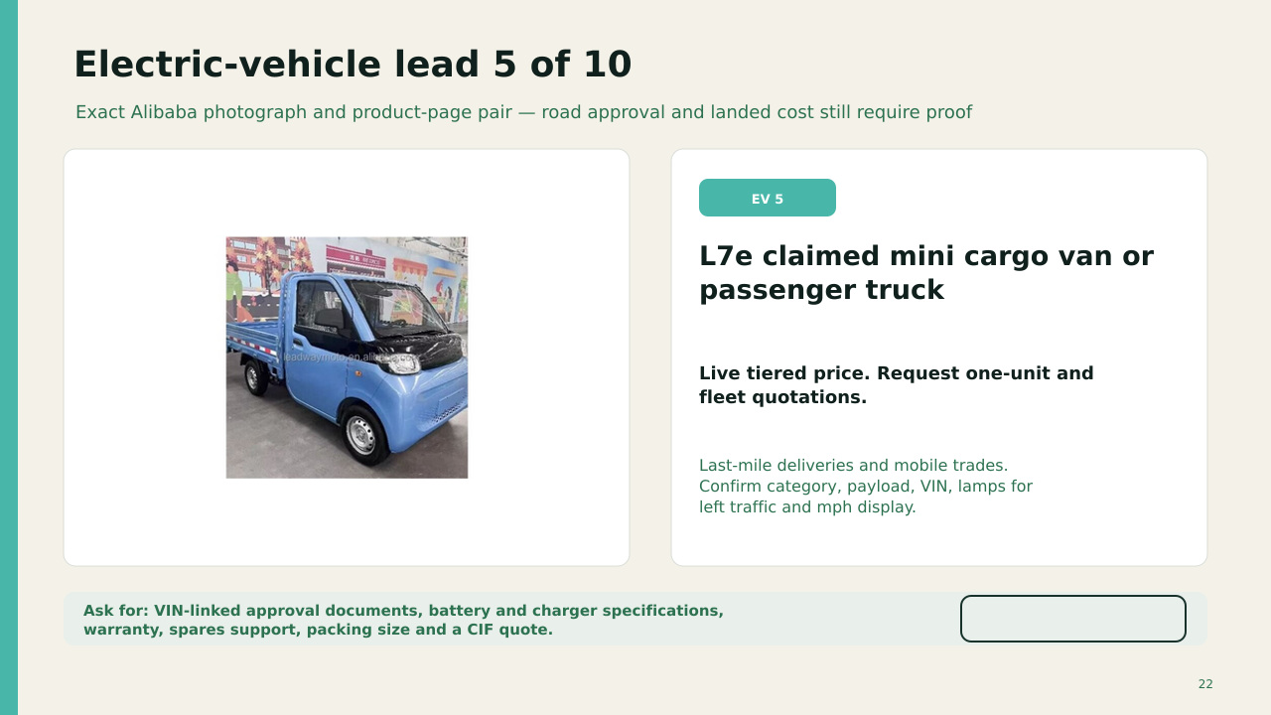
OPEN ALIBABA LISTING
MODEL PRICE £3,700
Seller tier hidden. Written quote required.
Cargo payload and category need proof. The comparison price excludes business fit-out and road approval work.
QTY | BUY DISC. | SHIP + UK / UNIT | LANDED / UNIT | ORDER TOTAL | SUPPLY
1 | 0% | £2.0k | £7.5k | £7.5k | 8–14 wk
10 | 5% | £1.0k | £6.0k | £59.6k | 10–18 wk
100 | 12% | £750 | £5.3k | £529k | 4–8 mo
1,000 | 18% | £650 | £4.9k | £4.86m | 1–2 yr
1m | 25% | £500 | £4.3k | £4.32bn | 5–10+ yr
Model: factory price after shown buying discount + estimated freight and UK delivery; then a cautious 10% duty allowance and 20% import VAT. Excludes testing, modification, DVLA, plates and insurance. Commission 0.5–2 days; GB road approval can take longer or fail.
OPEN ALIBABA LISTING
Notes:
The OPEN ALIBABA LISTING label links to this exact product page. The Alibaba-hosted photograph was matched through indexed image results on 12 September 2026. Listing content can change or disappear.
Sources checked 12 September 2026:
https://www.alibaba.com/product-detail/China-EEC-L7e-Used-Electric-Mini_1601402533155.html
https://s.alicdn.com/@sc04/kf/He149c115023347bab268999a657e44a5f.png_720x720q50.jpg
Pricing and scale model added 12 September 2026.
FX planning rate: US$1.35 per £1.
Buying discounts and freight reductions are scenario assumptions, not supplier quotations.
Import VAT basis: https://www.gov.uk/goods-sent-from-abroad/tax-and-duty
Freight volatility reference: https://www.freightos.com/shipping-routes/shipping-from-china-to-the-uk/
Current Alibaba market benchmark page: https://www.alibaba.com/countrysearch/CN/home-and-house.html
Exact product link: https://www.alibaba.com/product-detail/L7e-electric-mini-cargo-van-electric_1601402533155.html

Slide 23
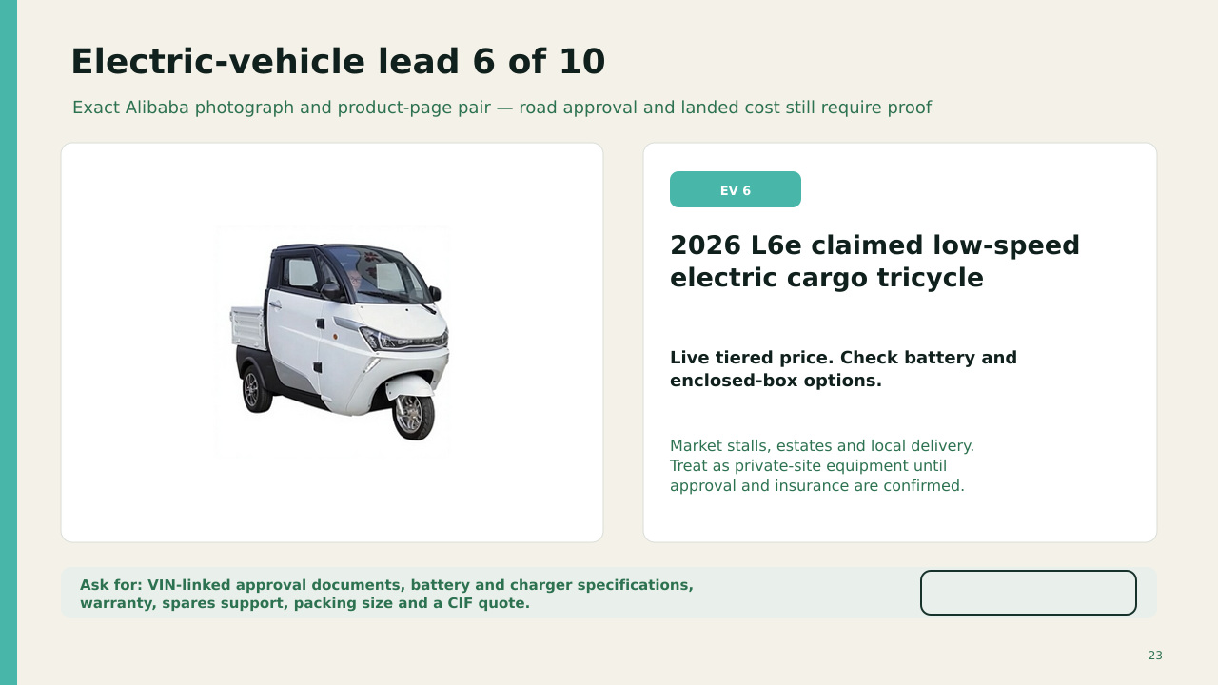
OPEN ALIBABA LISTING
MODEL PRICE £2,200
Seller tier hidden. Written quote required.
Private-site use may be the practical route. Confirm enclosed-box options, battery transport evidence and spares.
QTY | BUY DISC. | SHIP + UK / UNIT | LANDED / UNIT | ORDER TOTAL | SUPPLY
1 | 0% | £2.0k | £5.5k | £5.5k | 8–14 wk
10 | 5% | £1.0k | £4.1k | £40.8k | 10–18 wk
100 | 12% | £750 | £3.5k | £355k | 4–8 mo
1,000 | 18% | £650 | £3.2k | £3.24m | 1–2 yr
1m | 25% | £500 | £2.8k | £2.84bn | 5–10+ yr
Model: factory price after shown buying discount + estimated freight and UK delivery; then a cautious 10% duty allowance and 20% import VAT. Excludes testing, modification, DVLA, plates and insurance. Commission 0.5–2 days; GB road approval can take longer or fail.
OPEN ALIBABA LISTING
Notes:
The OPEN ALIBABA LISTING label links to this exact product page. The Alibaba-hosted photograph was matched through indexed image results on 12 September 2026. Listing content can change or disappear.
Sources checked 12 September 2026:
https://www.alibaba.com/product-detail/2026-Chinese-Manufacture-EEC-L6E-Low_1601671705743.html
https://s.alicdn.com/@sc04/kf/H34acd06fc94f4756b4ec08aea11fd96bz.png_960x960q80.jpg
Pricing and scale model added 12 September 2026.
FX planning rate: US$1.35 per £1.
Buying discounts and freight reductions are scenario assumptions, not supplier quotations.
Import VAT basis: https://www.gov.uk/goods-sent-from-abroad/tax-and-duty
Freight volatility reference: https://www.freightos.com/shipping-routes/shipping-from-china-to-the-uk/
Current Alibaba market benchmark page: https://www.alibaba.com/countrysearch/CN/home-and-house.html
Exact product link: https://www.alibaba.com/product-detail/2026-L6e-EEC-electric-cargo-tricycle_1601671705743.html

Slide 24
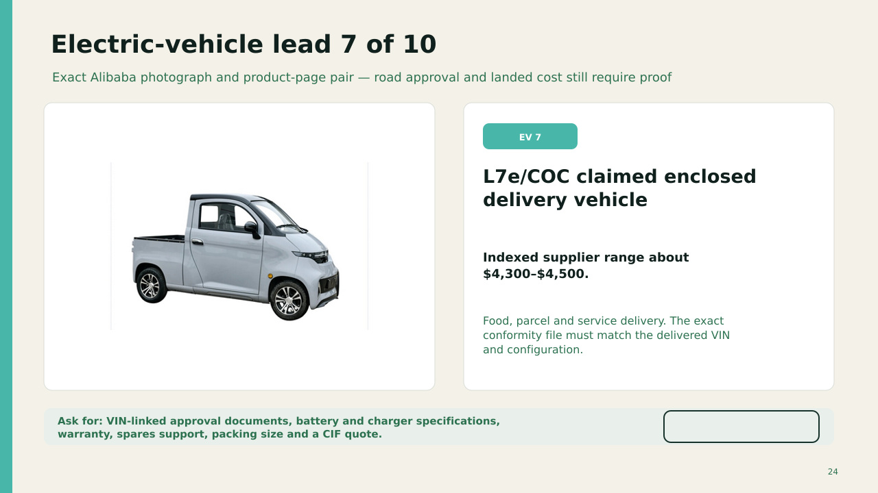
OPEN ALIBABA LISTING
INDEXED PRICE £3,185–£3,333
US$4,300–4,500 indexed.
The exact conformity file must match the delivered VIN and configuration. Seller badges alone do not prove approval.
QTY | BUY DISC. | SHIP + UK / UNIT | LANDED / UNIT | ORDER TOTAL | SUPPLY
1 | 0% | £2.0k | £6.9k | £6.9k | 8–14 wk
10 | 5% | £1.0k | £5.4k | £54.1k | 10–18 wk
100 | 12% | £750 | £4.8k | £478k | 4–8 mo
1,000 | 18% | £650 | £4.4k | £4.39m | 1–2 yr
1m | 25% | £500 | £3.9k | £3.89bn | 5–10+ yr
Model: factory price after shown buying discount + estimated freight and UK delivery; then a cautious 10% duty allowance and 20% import VAT. Excludes testing, modification, DVLA, plates and insurance. Commission 0.5–2 days; GB road approval can take longer or fail.
OPEN ALIBABA LISTING
Notes:
The OPEN ALIBABA LISTING label links to this exact product page. The Alibaba-hosted photograph was matched through indexed image results on 12 September 2026. Listing content can change or disappear.
Sources checked 12 September 2026:
https://www.alibaba.com/product-detail/express-food-delivery-vehicle-L7e-eec_1601068553392.html
https://sc04.alicdn.com/kf/Hb37574dec96b4bf485178def1baa1b3cX/238997453/Hb37574dec96b4bf485178def1baa1b3cX.jpg
Pricing and scale model added 12 September 2026.
FX planning rate: US$1.35 per £1.
Buying discounts and freight reductions are scenario assumptions, not supplier quotations.
Import VAT basis: https://www.gov.uk/goods-sent-from-abroad/tax-and-duty
Freight volatility reference: https://www.freightos.com/shipping-routes/shipping-from-china-to-the-uk/
Current Alibaba market benchmark page: https://www.alibaba.com/countrysearch/CN/home-and-house.html
Exact product link: https://www.alibaba.com/product-detail/L7e-enclosed-electric-vehicle-China-manufacturer_1601068553392.html

Slide 25
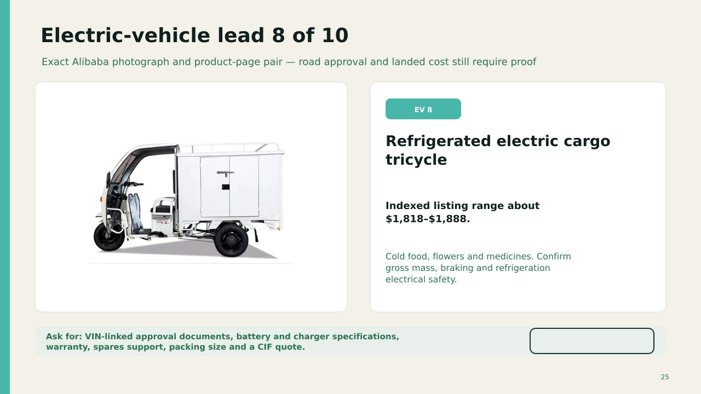
OPEN ALIBABA LISTING
INDEXED PRICE £1,347–£1,399
US$1,818–1,888 indexed.
Refrigeration adds electrical load, mass and service needs. Confirm payload and temperature performance.
QTY | BUY DISC. | SHIP + UK / UNIT | LANDED / UNIT | ORDER TOTAL | SUPPLY
1 | 0% | £2.0k | £4.5k | £4.5k | 8–14 wk
10 | 5% | £1.0k | £3.0k | £30.4k | 10–18 wk
100 | 12% | £750 | £2.6k | £258k | 4–8 mo
1,000 | 18% | £650 | £2.3k | £2.34m | 1–2 yr
1m | 25% | £500 | £2.0k | £2.02bn | 5–10+ yr
Model: factory price after shown buying discount + estimated freight and UK delivery; then a cautious 10% duty allowance and 20% import VAT. Excludes testing, modification, DVLA, plates and insurance. Commission 0.5–2 days; GB road approval can take longer or fail.
OPEN ALIBABA LISTING
Notes:
The OPEN ALIBABA LISTING label links to this exact product page. The Alibaba-hosted photograph was matched through indexed image results on 12 September 2026. Listing content can change or disappear.
Sources checked 12 September 2026:
https://www.alibaba.com/product-detail/small-Freeze-refrigerated-transportation-cargo-tricycle_1600156723073.html
https://sc01.alicdn.com/kf/Ha0d53adb1d324f1ea7d2d74c3fddda2aa/239440540/Ha0d53adb1d324f1ea7d2d74c3fddda2aa.jpg
Pricing and scale model added 12 September 2026.
FX planning rate: US$1.35 per £1.
Buying discounts and freight reductions are scenario assumptions, not supplier quotations.
Import VAT basis: https://www.gov.uk/goods-sent-from-abroad/tax-and-duty
Freight volatility reference: https://www.freightos.com/shipping-routes/shipping-from-china-to-the-uk/
Current Alibaba market benchmark page: https://www.alibaba.com/countrysearch/CN/home-and-house.html
Exact product link: https://www.alibaba.com/product-detail/Refrigerated-Electric-Cargo-Tricycle-with-Refrigeration_1600156723073.html

Slide 26
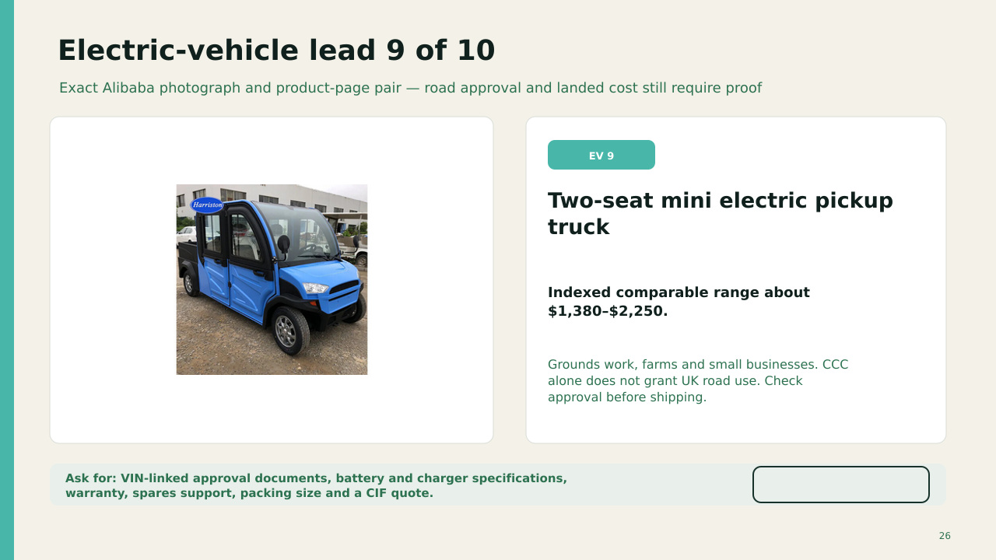
OPEN ALIBABA LISTING
INDEXED PRICE £1,022–£1,667
US$1,380–2,250 indexed.
A low price can mean a lead-acid battery or limited equipment. Confirm range under payload and charger voltage.
QTY | BUY DISC. | SHIP + UK / UNIT | LANDED / UNIT | ORDER TOTAL | SUPPLY
1 | 0% | £2.0k | £4.4k | £4.4k | 8–14 wk
10 | 5% | £1.0k | £3.0k | £30.1k | 10–18 wk
100 | 12% | £750 | £2.6k | £255k | 4–8 mo
1,000 | 18% | £650 | £2.3k | £2.31m | 1–2 yr
1m | 25% | £500 | £2.0k | £1.99bn | 5–10+ yr
Model: factory price after shown buying discount + estimated freight and UK delivery; then a cautious 10% duty allowance and 20% import VAT. Excludes testing, modification, DVLA, plates and insurance. Commission 0.5–2 days; GB road approval can take longer or fail.
OPEN ALIBABA LISTING
Notes:
The OPEN ALIBABA LISTING label links to this exact product page. The Alibaba-hosted photograph was matched through indexed image results on 12 September 2026. Listing content can change or disappear.
Sources checked 12 September 2026:
https://www.alibaba.com/product-detail/New-energy-electric-mini-truck-electric_62324659233.html
https://sc02.alicdn.com/kf/H52fd1511cac04d518c39927387262802k/229807408/H52fd1511cac04d518c39927387262802k.jpg
Pricing and scale model added 12 September 2026.
FX planning rate: US$1.35 per £1.
Buying discounts and freight reductions are scenario assumptions, not supplier quotations.
Import VAT basis: https://www.gov.uk/goods-sent-from-abroad/tax-and-duty
Freight volatility reference: https://www.freightos.com/shipping-routes/shipping-from-china-to-the-uk/
Current Alibaba market benchmark page: https://www.alibaba.com/countrysearch/CN/home-and-house.html
Exact product link: https://www.alibaba.com/product-detail/Electric-Mini-Truck-with-Cargo-Box_62324659233.html

Slide 27
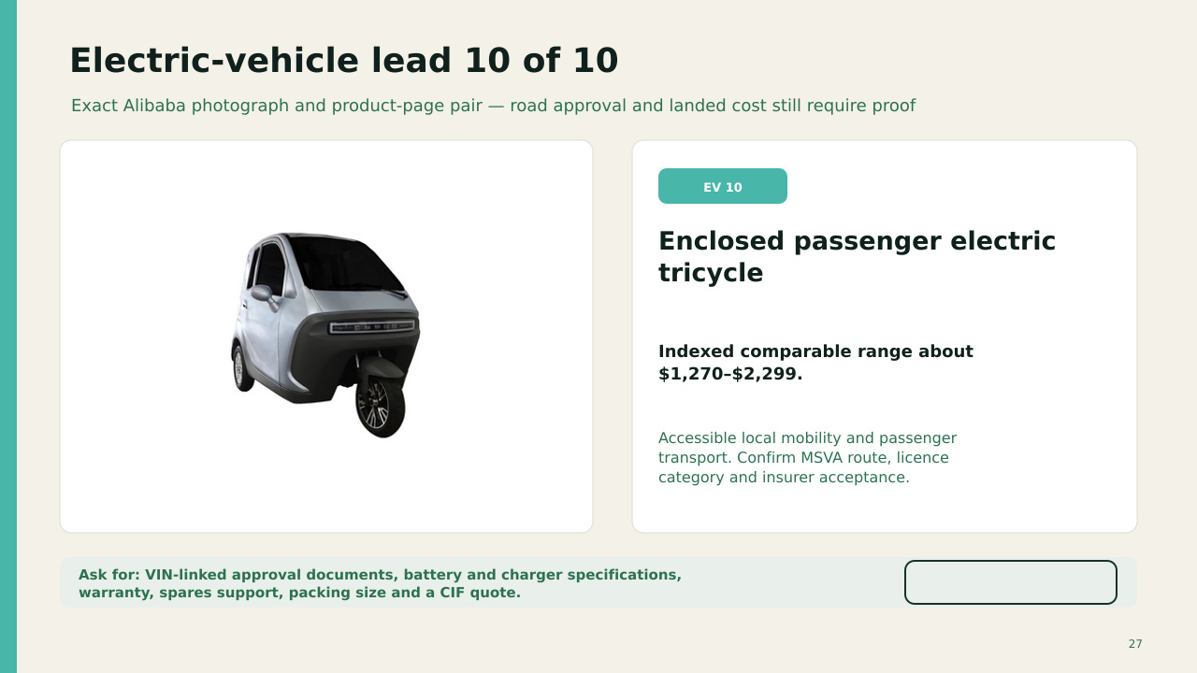
OPEN ALIBABA LISTING
INDEXED PRICE £941–£2,221
US$1,270–2,999 indexed.
Confirm MSVA route, licence category, passenger capacity and whether an insurer will quote the exact model.
QTY | BUY DISC. | SHIP + UK / UNIT | LANDED / UNIT | ORDER TOTAL | SUPPLY
1 | 0% | £2.0k | £4.7k | £4.7k | 8–14 wk
10 | 5% | £1.0k | £3.3k | £33.0k | 10–18 wk
100 | 12% | £750 | £2.8k | £283k | 4–8 mo
1,000 | 18% | £650 | £2.6k | £2.57m | 1–2 yr
1m | 25% | £500 | £2.2k | £2.23bn | 5–10+ yr
Model: factory price after shown buying discount + estimated freight and UK delivery; then a cautious 10% duty allowance and 20% import VAT. Excludes testing, modification, DVLA, plates and insurance. Commission 0.5–2 days; GB road approval can take longer or fail.
OPEN ALIBABA LISTING
Notes:
The OPEN ALIBABA LISTING label links to this exact product page. The Alibaba-hosted photograph was matched through indexed image results on 12 September 2026. Listing content can change or disappear.
Sources checked 12 September 2026:
https://www.alibaba.com/product-detail/High-quality-passenger-transport-electric-tricycle_1601105102694.html
https://sc04.alicdn.com/kf/Hbcadcd73beec40899f87088db1434acd8/231051214/Hbcadcd73beec40899f87088db1434acd8.png
Pricing and scale model added 12 September 2026.
FX planning rate: US$1.35 per £1.
Buying discounts and freight reductions are scenario assumptions, not supplier quotations.
Import VAT basis: https://www.gov.uk/goods-sent-from-abroad/tax-and-duty
Freight volatility reference: https://www.freightos.com/shipping-routes/shipping-from-china-to-the-uk/
Current Alibaba market benchmark page: https://www.alibaba.com/countrysearch/CN/home-and-house.html
Exact product link: https://www.alibaba.com/product-detail/Passenger-Electric-Tricycle-Enclosed-3-Wheel_1601105102694.html

Slide 28
Road use begins with classification, not the seller badge
An Alibaba EEC or COC claim does not guarantee registration in Great Britain
1
Exact vehicle file
VIN, mass, power, speed, seats, dimensions, glazing, lamps, brakes and battery documents
2
Approval route
Provisional GB type approval, valid conformity evidence, MSVA or Partial MSVA as the authority directs
3
Import record
Customs declaration, VAT and duty, then HMRC notification or NOVA where required
4
Road entry
DVLA registration and tax, number plates, correct licence category, insurance and MOT when due
Before paying: ask DVSA, DVLA and a willing insurer about the exact model and document set.
28
Notes:
GOV.UK says a motorcycle, three-wheeled or light four-wheeled vehicle needs provisional GB type approval or the MSVA route. Licence category depends on the vehicle classification and the driver's entitlement.
Sources checked 12 September 2026:
https://www.gov.uk/importing-vehicles-into-the-uk
https://www.gov.uk/importing-vehicles-into-the-uk/telling-hmrc
https://www.gov.uk/vehicle-approval/motorcycle-single-vehicle-approval
https://www.gov.uk/quad-bikes-the-rules

Slide 29
A $2,500 EV can exceed £5,000 before insurance
Illustrative planning case using US$1.352 per £1 and a hypothetical 10% duty rate
Vehicle list price
£1,849
Freight and insurance
£2,000
Illustrative duty
£385
Import VAT
£847
Test, modification and registration allowance
£800
Illustrative total £5,881. Approval may still fail, while insurance, tyres, spare parts and charger changes remain extra.
29
Notes:
This is an arithmetic scenario, not a freight quote or tariff ruling. VAT is illustrated on product, freight and duty. Verify the commodity code and customs value.
Sources checked 12 September 2026:
https://www.gov.uk/goods-sent-from-abroad/tax-and-duty
https://www.gov.uk/trade-tariff
https://www.gov.uk/importing-vehicles-into-the-uk
https://www.reuters.com/world/uk/pound-climbs-after-uk-growth-beats-expectations-2026-09-11/

Slide 30
No deposit before the evidence package is complete
The cheapest safe purchase starts with documents, samples and independent inspection
HOME ORDER
VEHICLE ORDER
Exact two-bedroom drawings and bill of materials
VIN-linked CoC or full technical specification before payment
Rock wool in walls, roof and floor with density and test reports
Written GB approval route agreed with the relevant authority
Structural calculations for UK wind, snow and transport loads
Insurer confirms willingness to quote the exact make and model
Electrical and plumbing specification for UK installation
Battery chemistry, UN 38.3 transport evidence and replacement cost
Written Incoterm, packing list, weight and delivery dimensions
Right-hand traffic conversion needs, mph display and 230 V charger
Independent factory inspection and video of the completed unit
Spare parts list, diagnostics, warranty process and repair contact
Keep payment inside Alibaba Trade Assurance and make the signed specification part of the order.
30
Notes:
Independent inspection and contract advice remain prudent for a high-value international purchase.
Sources checked 12 September 2026:
https://www.gov.uk/import-goods-into-uk
https://www.gov.uk/vehicle-approval/motorcycle-single-vehicle-approval
https://www.gov.uk/guidance/approved-document-b-fire-safety-frequently-asked-questions
https://www.gov.uk/government/publications/approved-document-l-2026

Slide 31
Land and permission convert low-cost structures into real lives
A practical pilot could preserve safety while removing avoidable scarcity
Serviced land
Public or community land offered through long leases instead of speculative resale
Pre-agreed patterns
A small catalogue of modular designs assessed for structure, fire, energy and accessibility
Simple ground systems
Prepared hardstanding or pile grids with power, water, drainage and safe access
Resident control
Secure tenure, transparent costs, repair rights and routes into ownership
People gain time to learn, care, create and work when shelter and mobility stop consuming an entire lifetime of debt.
31
Notes:
Sources checked 12 September 2026:
https://www.gov.uk/planning-permission-england-wales
https://www.gov.uk/building-regulations-approval
https://www.gov.uk/government/publications/approved-document-l-2026
https://www.gov.uk/guidance/approved-document-b-fire-safety-frequently-asked-questions

Slide 32
Owning a home need not be reserved for the wealthy
Affordable structures and vehicles already exist. The open question is how safely and fairly people can access land, permission and lawful use.
This shortlist shows possibility, not certainty.
The next responsible step is a pilot with one site, one building-control route, one independently inspected home and one vehicle pre-cleared for approval and insurance.
Life should leave room for contribution, care and freedom.
32
Notes:
A pilot should use current professional advice. This deck does not provide legal, engineering, customs or financial advice.
Sources checked 12 September 2026:
https://m.alibaba.com/countrysearch/CN/customized-homes.html
https://www.alibaba.com/countrysearch/CN/electric-car-eec-certificate.html
https://www.gov.uk/planning-permission-england-wales
https://www.gov.uk/importing-vehicles-into-the-uk

