Slide 1
RAINWATER
Climate evidence, useful storage and public questions
Green Tank | 23 September 2026
Notes:
A public discussion deck. Separate observed climate data from forecasts, storage proposals and legal responsibilities. Data reviewed as of 23 September 2026.

Slide 2
The proposal: store some roof rain for useful work
1,000 L
Caged IBC for a garden or a small non-drinking reserve
10,000 L
A larger tank for a suitable household, farm building or worksite
40,000 L
Possible supplementary firefighting supply, if a fire authority judges it useful
100,000 L
Possible farm emergency buffer, sized to actual demand and available roof area
The questions are about safe siting, available rain, intended use and who can answer in writing.
Proposed capacities are examples, not standards
2
Notes:
These are the user’s discussion proposals. No national rule requiring 40,000 L per station or 100,000 L per farm was identified. Fire and Rescue Services Act 2004 s38: https://www.legislation.gov.uk/ukpga/2004/21/section/38

Slide 3
Gas from a bottle; water from an open surface
Your comparison raises a real physical question.
A gas released from a bottle mixes into the surrounding air.
Liquid water at an exposed surface can turn into invisible water vapour. Sunlight, warmth, wind and humidity affect the rate.
Vapour travels, condenses and can fall again as rain. It may return somewhere else.
Met Office water cycle; USGS lakes and reservoirs
3
Notes:
This analogy is a prompt to discuss evaporation. Liquid water does not float away as a liquid. Water vapour is gaseous. Met Office: https://www.metoffice.gov.uk/blog/2025/how-does-the-water-cycle-affect-uk-weather . USGS: https://www.usgs.gov/water-science-school/science/lakes-and-reservoirs .

Slide 4
A lake is an open water store
Rain, river inflow and groundwater can replenish a lake.
Evaporation, river outflow, seepage and withdrawals reduce what remains. The level rises or falls according to the balance.
A covered tank limits exposure, but stored roof water still needs screening, overflow planning, maintenance and clear labels for non-drinking use.
USGS water balance; Met Office water cycle
4
Notes:
USGS lakes: https://www.usgs.gov/water-science-school/science/lakes-and-reservoirs . Met Office water cycle: https://www.metoffice.gov.uk/blog/2025/how-does-the-water-cycle-affect-uk-weather . Do not imply evaporation destroys water or guarantees rainfall in the same catchment.

Slide 5
UK climate: observed warming and variable rainfall
+1.33°C
16.5°C
UK average, 2016–2025 versus 1961–1990
Provisional UK mean for summer 2026, the warmest summer in the series
2016–2025 winter half-years were 13% wetter than 1961–1990. Heat, rainfall timing and river flows still shape local water shortages.
Met Office, State of the UK Climate 2025; summer 2026 provisional
5
Notes:
Met Office State of the UK Climate 2025: https://www.metoffice.gov.uk/research/climate/maps-and-data/about/state-of-climate . Summer 2026: https://www.metoffice.gov.uk/about-us/news-and-media/media-centre/weather-and-climate-news/2026/summer-2026-provisionally-hottest-on-record-for-the-uk . The 16.5°C figure is seasonal mean temperature, not daily maximum.

Slide 6
UK seasonal high / low averages, 2011–2018
Each pair is the seasonal mean daily maximum / mean daily minimum. It is not the hottest or coldest single day.
Year | Winter °C | Spring °C | Summer °C | Autumn °C | Summer rain mm | Year rain mm
2011 | 5.3 / −0.5 | 13.5 / 4.8 | 18.0 / 9.4 | 14.6 / 7.9 | 266 | 1,163
2012 | 7.4 / 1.7 | 12.4 / 4.0 | 17.7 / 10.2 | 12.1 / 5.2 | 379 | 1,330
2013 | 6.0 / 0.6 | 9.8 / 2.2 | 19.8 / 10.6 | 13.1 / 6.5 | 186 | 1,084
2014 | 8.0 / 2.4 | 13.0 / 5.1 | 19.3 / 10.4 | 14.3 / 7.4 | 257 | 1,292
2015 | 6.9 / 0.9 | 11.8 / 3.5 | 18.2 / 9.7 | 13.6 / 6.4 | 268 | 1,264
2016 | 8.4 / 2.6 | 11.8 / 3.6 | 19.0 / 10.9 | 13.2 / 6.3 | 260 | 1,096
2017 | 7.9 / 2.1 | 13.3 / 5.0 | 18.8 / 10.7 | 13.1 / 6.6 | 314 | 1,118
2018 | 6.4 / 0.7 | 12.1 / 4.1 | 20.6 / 11.0 | 13.2 / 6.2 | 172 | 1,053
Winter uses December of the previous year with January and February shown.
Met Office HadUK-Grid: UK area mean daily maximum / minimum; rain in mm
6
Notes:
Source Met Office UK HadUK-Grid seasonal data. Tmax: https://www.metoffice.gov.uk/pub/data/weather/uk/climate/datasets/Tmax/date/UK.txt . Tmin: https://www.metoffice.gov.uk/pub/data/weather/uk/climate/datasets/Tmin/date/UK.txt . Rainfall: https://www.metoffice.gov.uk/pub/data/weather/uk/climate/datasets/Rainfall/date/UK.txt . Values rounded to 0.1°C and whole mm. In winter row 2011, December is December 2010.

Slide 7
UK seasonal high / low averages, 2019–2025
Each pair is the seasonal mean daily maximum / mean daily minimum. It is not the hottest or coldest single day.
Year | Winter °C | Spring °C | Summer °C | Autumn °C | Summer rain mm | Year rain mm
2019 | 8.2 / 2.0 | 12.6 / 4.2 | 19.4 / 11.0 | 12.4 / 5.8 | 331 | 1,232
2020 | 8.1 / 2.5 | 13.4 / 4.0 | 18.8 / 10.7 | 13.4 / 6.6 | 326 | 1,334
2021 | 6.2 / 0.8 | 11.4 / 2.8 | 19.6 / 11.1 | 14.2 / 7.5 | 186 | 1,106
2022 | 8.1 / 2.3 | 13.2 / 4.6 | 20.6 / 10.9 | 14.4 / 7.7 | 162 | 1,091
2023 | 7.3 / 1.3 | 12.4 / 4.4 | 19.8 / 11.0 | 14.2 / 7.3 | 286 | 1,322
2024 | 8.0 / 2.6 | 13.1 / 5.7 | 18.6 / 10.2 | 13.3 / 6.6 | 244 | 1,269
2025 | 7.3 / 1.9 | 14.6 / 4.5 | 20.7 / 11.6 | 13.4 / 6.9 | 215 | 1,061
Winter uses December of the previous year with January and February shown.
Met Office HadUK-Grid: UK area mean daily maximum / minimum; rain in mm
7
Notes:
Source Met Office UK HadUK-Grid seasonal data. Tmax: https://www.metoffice.gov.uk/pub/data/weather/uk/climate/datasets/Tmax/date/UK.txt . Tmin: https://www.metoffice.gov.uk/pub/data/weather/uk/climate/datasets/Tmin/date/UK.txt . Rainfall: https://www.metoffice.gov.uk/pub/data/weather/uk/climate/datasets/Rainfall/date/UK.txt . Values rounded to 0.1°C and whole mm. In winter row 2011, December is December 2010.

Slide 8
UK rainfall year by year, 2011–2025
Year | Summer mm | Year mm
2011 | 266 | 1,163
2012 | 379 | 1,330
2013 | 186 | 1,084
2014 | 257 | 1,292
2015 | 268 | 1,264
2016 | 260 | 1,096
2017 | 314 | 1,118
2018 | 172 | 1,053
Year | Summer mm | Year mm
2019 | 331 | 1,232
2020 | 326 | 1,334
2021 | 186 | 1,106
2022 | 162 | 1,091
2023 | 286 | 1,322
2024 | 244 | 1,269
2025 | 215 | 1,061
Examples: 379 mm in summer 2012, 172 mm in 2018 and 162 mm in 2022. UK-wide totals can conceal a local dry spell.
Met Office HadUK-Grid, UK area mean rainfall
8
Notes:
Direct dataset: https://www.metoffice.gov.uk/pub/data/weather/uk/climate/datasets/Rainfall/date/UK.txt . Summer is June–August, annual is Jan–Dec. UK area average is not a Devon forecast.

Slide 9
Summer rain varies sharply from year to year
The trend in temperature does not mean every summer receives less rain.
Met Office HadUK-Grid, UK summer rainfall, millimetres
9
Notes:
Met Office rainfall source https://www.metoffice.gov.uk/pub/data/weather/uk/climate/datasets/Rainfall/date/UK.txt . The 2011–2025 period is too short to infer a monotonic change in UK summer rainfall. This chart shows interannual variation.

Slide 10
Global mean temperature, 2006–2025
Year | Global °C | Year | Global °C
2006 | 14.78 | 2016 | 15.14
2007 | 14.77 | 2017 | 15.04
2008 | 14.65 | 2018 | 14.96
2009 | 14.78 | 2019 | 15.08
2010 | 14.86 | 2020 | 15.12
2011 | 14.74 | 2021 | 14.96
2012 | 14.76 | 2022 | 15.01
2013 | 14.78 | 2023 | 15.32
2014 | 14.84 | 2024 | 15.39
2015 | 15.01 | 2025 | 15.29
Berkeley Earth preliminary high-resolution series, absolute estimate in °C
10
Notes:
Calculated from Berkeley Earth experimental high-resolution annual anomalies relative to 1951–1980, adding the dataset’s estimated 1951–1980 global mean of 14.107°C: https://storage.googleapis.com/berkeley-earth-temperature-hr/global/Global_TAVG_annual.txt . Preliminary method can change. Absolute global means differ by dataset method, so do not combine numerical levels across providers.

Slide 11
Global temperatures rise across the 20-year series
2006: 14.78°C 2025: 15.29°C Change between these endpoints: +0.51°C
Berkeley Earth, same-method absolute estimate, °C
11
Notes:
Berkeley Earth annual preliminary high-resolution data https://storage.googleapis.com/berkeley-earth-temperature-hr/global/Global_TAVG_annual.txt . These are absolute estimates for one method and rounded to 0.01°C. Two-year endpoint difference is not a fitted trend.

Slide 12
Independent climate sources agree on the warming trend
Berkeley Earth
One consistent 2006–2025 series reaches its highest estimate in 2024.
Copernicus
ERA5 estimates 2025 at 14.97°C and 0.21 ± 0.03°C warming per decade over 1979–2025.
NOAA
Reports global temperature against its own 20th-century reference, so its absolute levels cannot be mixed into the Berkeley chart.
Methods produce different absolute baselines. Compare trends and rankings within each dataset.
Copernicus ERA5; Berkeley Earth; NOAA NCEI
12
Notes:
Copernicus: https://climate.copernicus.eu/copernicus-2025-was-third-hottest-year-record and https://climate.copernicus.eu/climate-indicators/temperature . Berkeley Earth: https://storage.googleapis.com/berkeley-earth-temperature-hr/global/Global_TAVG_annual.txt . NOAA 2025: https://www.ncei.noaa.gov/access/monitoring/monthly-report/global/202513 .

Slide 13
El Niño raises global heat but does not set UK summer rain
Observed and forecast
WMO expects the strong 2026 El Niño to continue through February 2027. The Met Office says a global 2027 temperature record is very likely.
UK outlook
Late autumn and early winter 2026–27 currently favour warmer, wetter or stormier UK conditions. No official forecast establishes a dry UK summer in 2027.
WMO and Met Office, September 2026
13
Notes:
WMO update https://wmo.int/news/media-centre/el-nino-set-become-very-strong-raising-risks-of-extreme-weather-2027 . Met Office 22 Sep 2026 https://www.metoffice.gov.uk/blog/2026/record-breaking-el-nio-surpasses-previous-benchmarks- . UK autumn 2026 outlook https://www.metoffice.gov.uk/blog/2026/what-does-the-latest-long-range-forecast-tell-us-and-what-role-could-el-nio-play-this-autumn . Global forecast is not a prediction for one UK season.

Slide 14
AMOC: a measured weakening signal with large uncertainty
−0.9 ± 0.7
Sverdrups per decade over about 20 years at 26°N
RAPID scientists say observations through at least 2034 are needed to test the trend and its cause.
IPCC expects weakening this century and has medium confidence that abrupt collapse will not occur before 2100. Neither finding dates a UK drought in 2027.
National Oceanography Centre RAPID; IPCC AR6
14
Notes:
NOC original account https://www.noc.ac.uk/news/tracking-amoc-20-years-data-highlight-need-ongoing-observation . IPCC AR6 WGI SPM https://www.ipcc.ch/report/ar6/wg1/chapter/summary-for-policymakers/ . One Sverdrup means 1 million cubic metres per second. Trend uncertainty is part of the original NOC quote.

Slide 15
What the proposed reserves could actually do
Roof collection
500 m² × 800 mm/year × 80% capture ≈ 320,000 L/year. Refilling 100,000 L would require about 250 mm of rain on that roof.
Farm example
100 dairy cows using 100 L each per day need about 10,000 L/day. A 100,000 L reserve lasts roughly 10 days before losses or other uses.
Fire flow example
40,000 L at 1,000 L/min lasts 40 minutes in simple arithmetic. The fire authority must check actual access, flow and refill.
Illustrative arithmetic; site-specific planning required
15
Notes:
Roof estimate assumes all stated rainfall falls on the roof, 80% captures it and there are no additional losses. Dairy demand government range 68–155 L/cow/day: https://www.daera-ni.gov.uk/articles/water-advice-livestock-farmers . Fire flow is illustrative arithmetic, not a performance guarantee. One litre of water is roughly one kilogram, so 40,000 L is about 40 tonnes and 100,000 L about 100 tonnes excluding structure.

Slide 16
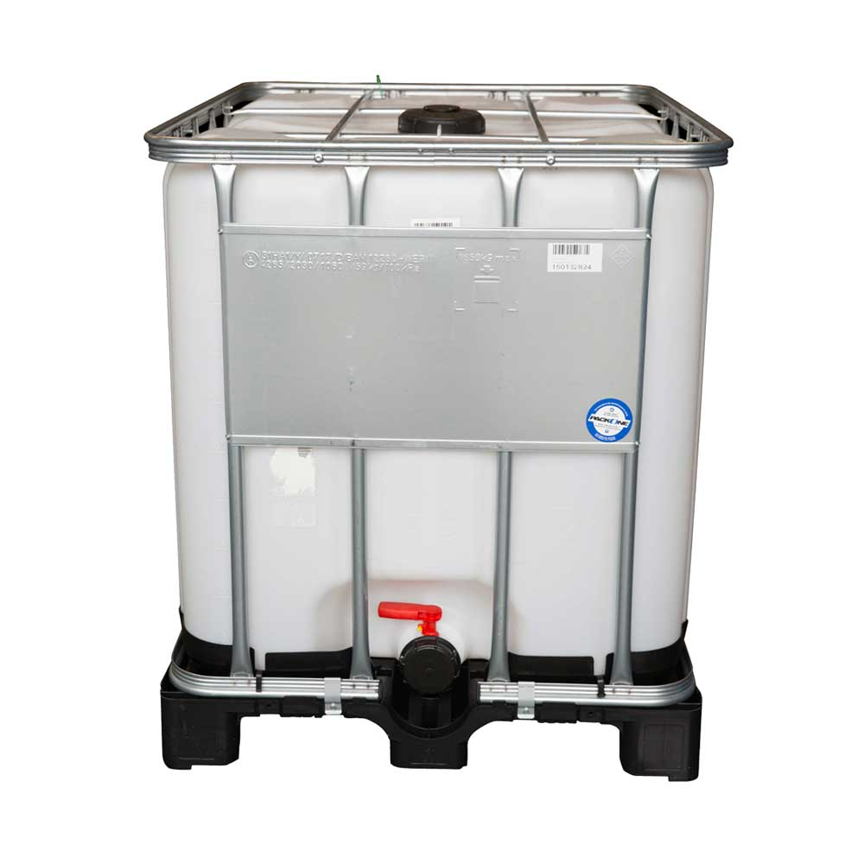
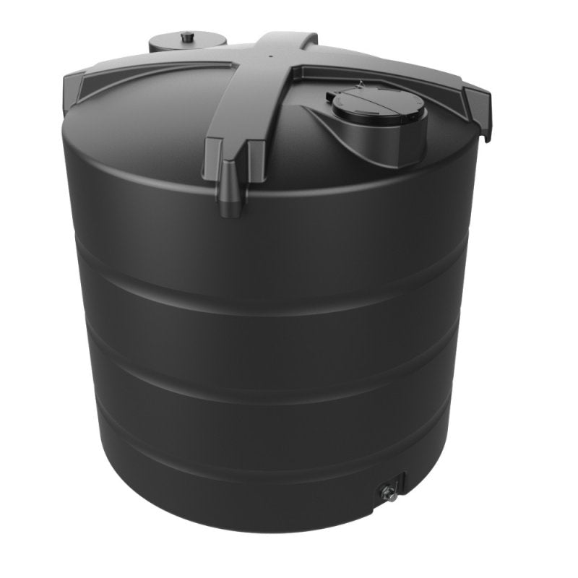
Small and medium tanks people can inspect
1,000 L caged IBC
10,000 L round tank
Hambleys: used, cleaned, described as food grade. £60 + VAT (£72). Delivery quote needed.
Tanks Direct: non-drinking use. £1,134 inc VAT advertised. Postcode shipping and offload need checking.
Retailer listings checked 23 September 2026; delivered prices depend on postcode
16
Notes:
Supplier photos © Hambleys and Tanks Direct, for listing identification in this presentation; obtain permission before reproducing on a public website. Hambleys https://hambleys.co.uk/product/1000-ltr-ibc-container-with-3-outlet-valve-steel-frame-and-plastic-pallet-base-food-grade/ . Tanks Direct https://tanks-direct.co.uk/products/10000-litre-round-water-tank-non-potable . Both prices dynamic. Food-grade-described used IBC is not proof that harvested roof water is safe to drink.

Slide 17
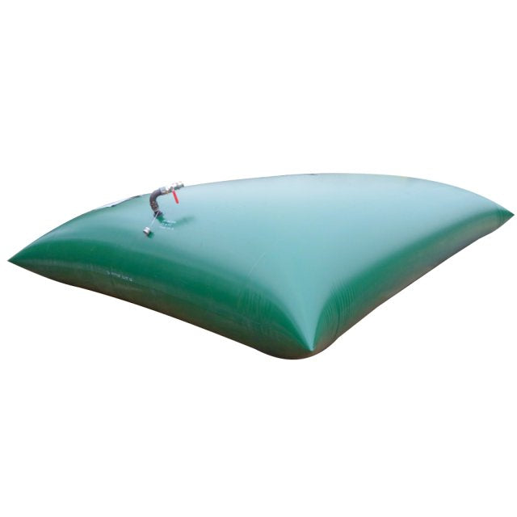
Large storage exists, with different forms and costs
40,000 L flexible bladder
Tanks Direct advertises a non-drinking bladder at £2,788.80 inc VAT. Verify the delivered cost, footprint, support and fire-service suitability.
20,000 L rigid tanks and 30,000 L vertical tanks are also listed. A 100,000 L farm reserve could require multiple tanks or a designed system.
A full 40,000 L store carries roughly 40 tonnes of water.
Retailer examples and delivery details checked 23 September 2026
17
Notes:
Product photo © Tanks Direct, for listing identification; get permission for public website reproduction. https://tanks-direct.co.uk/products/40000-litre-bladder-flexible-water-tank-non-potable . 20k product https://tanks-direct.co.uk/products/20000-litre-water-tank . 30k product https://www.directwatertanks.co.uk/enduramaxx-30000-litre-vertical-non-potable-water-tank . Shop categories can include underground, above-ground, bladder, potable-rated material, non-potable use. Delivered price, unloading, foundations and local constraints differ.

Slide 18
Which England rules can apply to rainwater storage?
Activity | Authority / rule | Practical result
Isolated roof rain | Environment Agency | Generally no abstraction licence under its conditions
River or groundwater | Environment Agency | A different activity; >20,000 L/day likely needs a licence
Tank location | Local planning authority | Site, scale, land status and structure can matter
Domestic rain supply | Council / private water rules | Council decides registration and health duties
Mains connection | Water undertaker / fittings rules | Keep mains protected from backflow and cross-connection
Firefighting supply | Fire and rescue authority | Adequate water duty; no 40,000 L per-station law
Each authority has a defined role; rules differ across the UK
18
Notes:
EA RPS https://www.gov.uk/government/publications/rainwater-harvesting-regulatory-position-statement/rainwater-harvesting-regulatory-position-statement . EA 20,000 L/day https://www.gov.uk/guidance/check-if-you-need-a-licence-to-abstract-water . Planning https://www.planningportal.co.uk/permission/common-projects/outbuildings/ . DWI private supplies https://www.dwi.gov.uk/private-water-supplies/local-authorities/faqs-and-useful-references/ . Water fittings https://www.legislation.gov.uk/uksi/1999/1148/contents and https://www.waterregsuk.co.uk/topics/all-faqs/can-mains-water-supplies-be-connected-to-installations-also-supplied-by-another-alternative-source-of-water/ . Fire s38 https://www.legislation.gov.uk/ukpga/2004/21/section/38 . 20,000 L/day is an abstraction rate, not a tank-size cap.

Slide 19
Drinking, toilets and the mains need different checks
Garden use
Rainwater used separately for a garden avoids any mains pipe connection.
Bucket flush
Pouring a separate bucket into a toilet pan creates no plumbing cross-connection. Ask the council about the exact domestic-supply position.
Plumbed toilets
DWI says a domestic rainwater system for toilet flushing can fall within private-water-supply rules. The mains must be protected.
Treatment is possible, but a tank labelled food grade and a filter alone do not prove that roof water is safe to drink.
DWI private supply guidance; Water Fittings Regulations 1999
19
Notes:
DWI FAQ on rainwater domestic use incl toilets https://www.dwi.gov.uk/private-water-supplies/local-authorities/faqs-and-useful-references/ . DWI private supply owners https://www.dwi.gov.uk/private-water-supplies/technical-information-notes/pws-regulations/guide-for-private-supply-owners-users/ . Mid Devon PWS registration https://www.middevon.gov.uk/residents/environment/private-water-supplies/ . Water Regs UK cross connection https://www.waterregsuk.co.uk/topics/all-faqs/can-mains-water-supplies-be-connected-to-installations-also-supplied-by-another-alternative-source-of-water/ . No blanket ban on a bucket was found, but classification should be determined by the council.

Slide 20
Written contacts: England and a Mid Devon example
Institution | Reason to write | Written contact
Environment Agency | Rainwater statement / abstraction | enquiries@environment-agency.gov.uk
Mid Devon planning | Is a tank permitted at this site? | middevon.gov.uk/residents/planning/contact-us-about-planning/
Mid Devon health | Private supply classification | health@middevon.gov.uk
South West Water | Mains fittings / backflow | customercontact@southwestwater.co.uk
Drinking Water Inspectorate | National quality guidance | dwi.enquiries@defra.gov.uk
Outside Mid Devon, substitute your own council and water undertaker.
Institutional addresses from official contact pages
20
Notes:
EA https://www.gov.uk/government/publications/rainwater-harvesting-regulatory-position-statement/rainwater-harvesting-regulatory-position-statement . Mid Devon planning https://www.middevon.gov.uk/residents/planning/contact-us-about-planning/ . Mid Devon PWS https://www.middevon.gov.uk/residents/environment/private-water-supplies/ . SWW https://www.southwestwater.co.uk/privacy . DWI https://www.dwi.gov.uk/what-we-do/contact-us/ . These are published institutional contact routes.

Slide 21
Fire planning and the other UK nations
Institution | Relevant role | Written contact
Devon & Somerset Fire | Fire water needs and suitable stores | comments@dsfire.gov.uk
South West Water WRMP29 | Water resource proposals | WRMP29@pennon-group.co.uk
Natural Resources Wales | Welsh abstraction questions | enquiries@naturalresourceswales.gov.uk
SEPA, Scotland | Scottish abstraction questions | beta.sepa.scot/about-sepa/contact-us/
NIEA, Northern Ireland | NI abstraction and impoundment | ail@daera-ni.gov.uk
Each nation has its own planning and private supply framework. An England position statement cannot answer for all four nations.
Written contacts for the right jurisdiction
21
Notes:
Devon & Somerset Fire https://www.dsfire.gov.uk/contact-us . South West Water WRMP29 https://www.southwestwater.co.uk/about-us/what-we-do/engineering-projects/drinking-water/water-resources-management-plan/wrmp29 . NRW https://naturalresourceswales.gov.uk/about-us/contact-us/general-enquiries/?lang=en . SEPA https://beta.sepa.scot/about-sepa/contact-us/ . NIEA https://www.daera-ni.gov.uk/contacts/water-management-unit .

Slide 22
Questions to ask after the facts
1. At a named property, what rule would require permission for an isolated roof-fed tank?
2. If an authority restricts a system, what exact law, site facts and health or environmental reason apply?
3. How should rainwater for toilets be separated from the drinking-water mains?
4. Would a proposed 40,000 L supply help the local fire service in practice?
5. What roof, demand and drought assumptions would justify 100,000 L on a particular farm?
6. What evidence, if any, could support a UK summer 2027 drought forecast?
Written answers and published legal grounds help everyone judge
22
Notes:
These are open public questions, not assertions that institutions own rain or that proposed capacities are required. Ask for written responses and update the record with dated corrections.

Slide 23
Evidence, replies and the reader’s own judgement
Observations
Met Office UK datasets and State of the UK Climate; Berkeley Earth; Copernicus.
Forecasts and uncertainties
WMO and Met Office for El Niño; NOC and IPCC for AMOC. No evidence here predicts UK summer 2027 drought.
Law and local answers
Environment Agency, DWI, the local council, the water company and the fire authority can give a written answer on a real plan.
Primary source links are also in each slide’s notes
23
Notes:
Met Office https://www.metoffice.gov.uk/research/climate/maps-and-data/about/state-of-climate ; UK Tmax/Tmin/rain https://www.metoffice.gov.uk/pub/data/weather/uk/climate/datasets/Tmax/date/UK.txt , https://www.metoffice.gov.uk/pub/data/weather/uk/climate/datasets/Tmin/date/UK.txt , https://www.metoffice.gov.uk/pub/data/weather/uk/climate/datasets/Rainfall/date/UK.txt ; Berkeley Earth https://storage.googleapis.com/berkeley-earth-temperature-hr/global/Global_TAVG_annual.txt ; Copernicus https://climate.copernicus.eu/climate-indicators/temperature ; WMO https://wmo.int/news/media-centre/el-nino-set-become-very-strong-raising-risks-of-extreme-weather-2027 ; NOC https://www.noc.ac.uk/news/tracking-amoc-20-years-data-highlight-need-ongoing-observation ; EA rainwater https://www.gov.uk/government/publications/rainwater-harvesting-regulatory-position-statement/rainwater-harvesting-regulatory-position-statement . Fela Kuti’s title “Water No Get Enemy” inspired the water theme; no song lyrics reproduced. Invite substantive dated replies and corrections.

