Slide 1
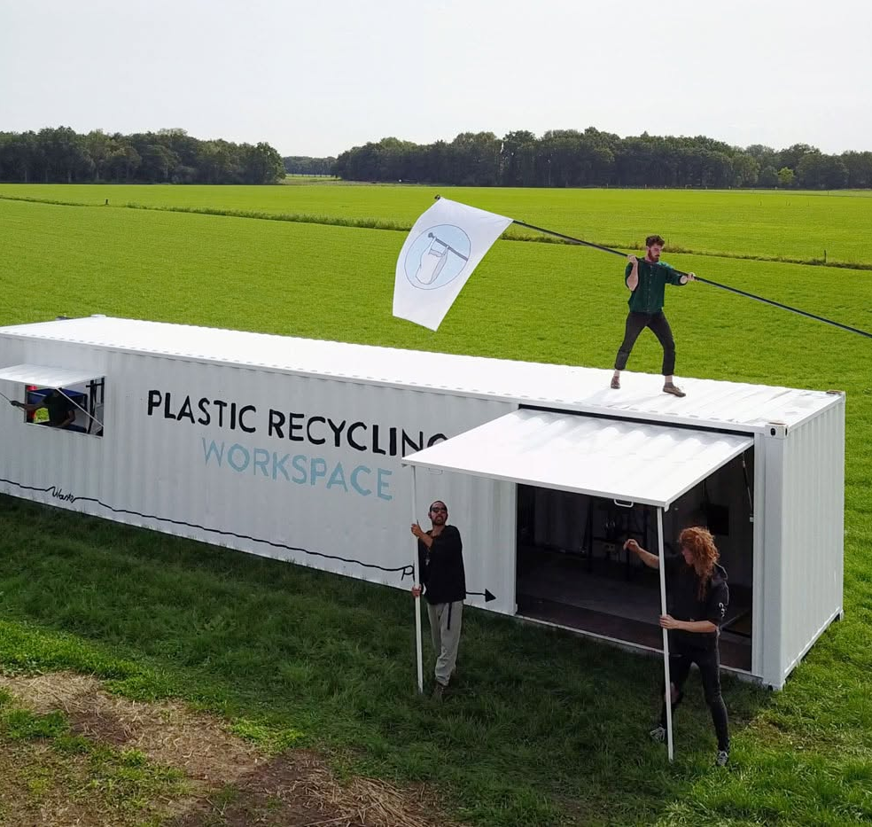
A LOCAL RECYCLING CONCEPT
Local
recycling
Useful products
made nearby
An introduction with examples
from Kenya, Colombia and beyond
Existing Precious Plastic container workshop • Photograph: Precious Plastic
Notes:
Introduce the idea: a visible local workshop which turns selected recovered materials into products people need and can buy. The photograph shows an existing Precious Plastic workspace, not a facility built for this proposal. Precious Plastic describes a real converted shipping container, exhibited at Dutch Design Week and later deployed with Parley in the Maldives. The workshop is a precedent for layout and access, not a supplier quotation or proof of the proposed budget.
Source: https://www.preciousplastic.com/our-solutions/shipping-container
Photo: Precious Plastic, https://cdn.prod.website-files.com/655b100fbab8837a5755c8a0/6a55c5f09a23e909fce41dea_Solutions-Container-cover.jpg
Research checked 10 October 2026.

Slide 2
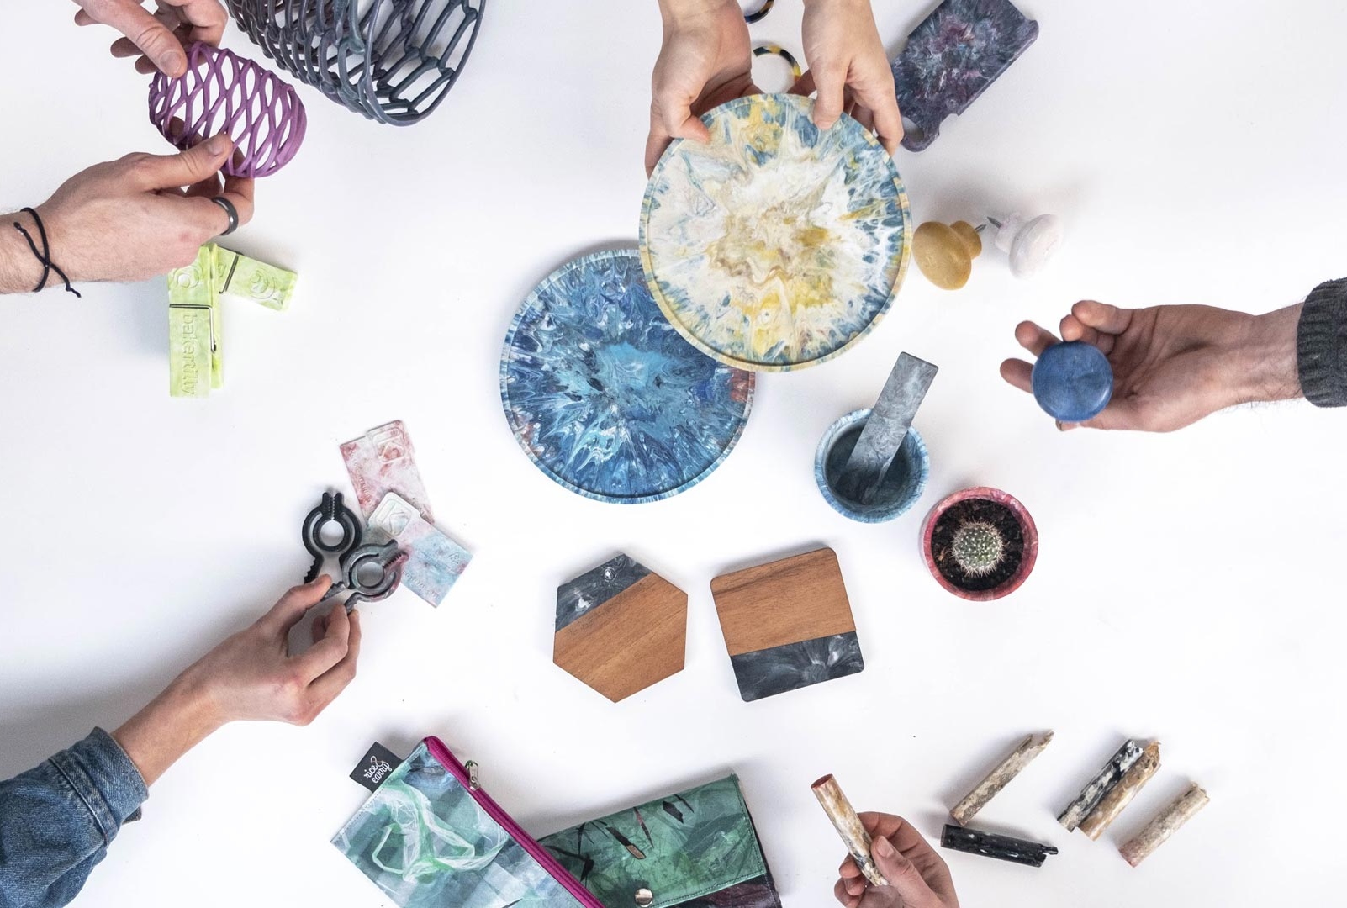
THE CONCEPT
A workshop people can visit
Bring selected materials
Residents and businesses supply clean, known materials.
Make products locally
Trained staff repair, sort and turn suitable material into useful items.
Buy and see the result
A public shop and batch records show where the material went.
Product examples: Precious Plastic community
Plastic processing and metal recovery use separate equipment and routes.
02
Notes:
This slide describes our proposal, not a completed project. A local facility would accept only materials for which it has a safe process and a buyer or use. Keep reuse ahead of reprocessing where practical. The proposed shop and batch records address the user's aim of giving residents confidence that collection leads to useful outputs. The product photograph illustrates the range of objects the Precious Plastic community makes, not products already made by our project. Plastic and metal work require different machinery, quality checks and operating controls.
Photo and product source: https://www.preciousplastic.com/
Photo asset: https://cdn.prod.website-files.com/655b100fbab8837a5755c8a0/6a55ccae3911dee91ddd8b0d_5e06d156ed2a273e066bde58_hero-landing-products.jpg
Proposal basis: Local Recycling and Manufacturing Paper, prepared 10 October 2026.

Slide 3
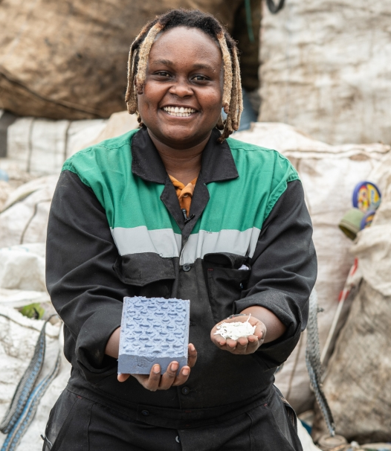
GJENGE MAKERS · NAIROBI, KENYA
Nzambi Matee
Plastic and sand
become paving blocks
Matee developed a process and machinery to turn discarded plastic into paving products.
A change people can walk on
At Mukuru Skills Training Centre, colourful pavers replaced dirt paths and playground surfaces.
Photograph: Georgina Smith / UNEP
03
Notes:
Nzambi Matee founded Gjenge Makers in Kenya. UNEP's December 2020 profile documents her development work and the installation at Mukuru Skills Training Centre. This is evidence of a concrete community use, not a current production total or a general claim that plastic pavers outperform every alternative. Partner Impacc also describes opportunities for women, young people and waste collectors. The lesson for our project is to select a useful, repeatable product and match its formulation to its job. Pavers and house wall blocks are different applications.
Sources: https://www.unep.org/news-and-stories/story/building-blocks-greener-nairobi
https://impacc.org/portfolio/gjenge-makers
Portrait source: https://www.unep.org/news-and-stories/story/meet-seven-women-saving-planet
Photograph: Georgina Smith / UNEP, https://cdn.unenvironment.org/s3fs-public/inline-images/Nzambi_Matee_2020_UNEP_Young_Champions_of_the_Earth_winner_credit_Georgina_Smith_UNEP115-compressed.jpg?VersionId=null

Slide 4
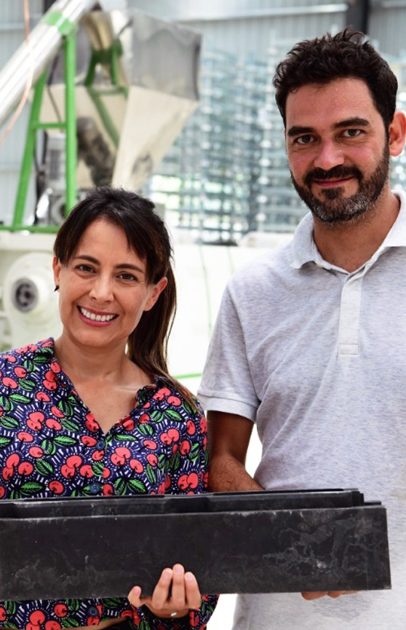
CONCEPTOS PLÁSTICOS · COLOMBIA + CÔTE D’IVOIRE
Isabel Cristina Gámez
& Óscar Andrés Méndez
Their modular plastic bricks helped UNICEF build classrooms in Côte d’Ivoire.
383
classrooms reported
by UNICEF USA in 2024
Serving 19,150 children
Gámez (left), Méndez (right)
Photograph: Conceptos Plásticos
© UNICEF / UN0616754 / Dejongh
04
Notes:
Conceptos Plásticos co-founders Isabel Cristina Gámez and Óscar Andrés Méndez developed a modular construction system in Colombia and worked with UNICEF in Côte d'Ivoire. UNICEF USA's article dated 3 May 2024 reports 383 classrooms and 19,150 children in its main text. An older photograph caption on that page still states 167 classrooms, so the figures on this slide follow the dated main article. They are reported cumulative outcomes, not independently audited 2026 totals. The same article describes stronger bargaining through women's recycling collectives. Structural systems require application-specific engineering and approval.
Founders and portrait: https://conceptosplasticos.com/content/history.html
Impact: https://www.unicefusa.org/stories/benefits-building-classrooms-out-recycled-plastic-bricks
Portrait asset: https://conceptosplasticos.com/content/images/history_01_CPWeb.jpg
School photograph: © UNICEF/UN0616754/Dejongh, https://www.unicefusa.org/sites/default/files/styles/full_width/public/2024-05/UN0616754%20%281%29.jpg.webp?itok=J9QUtyky

Slide 5
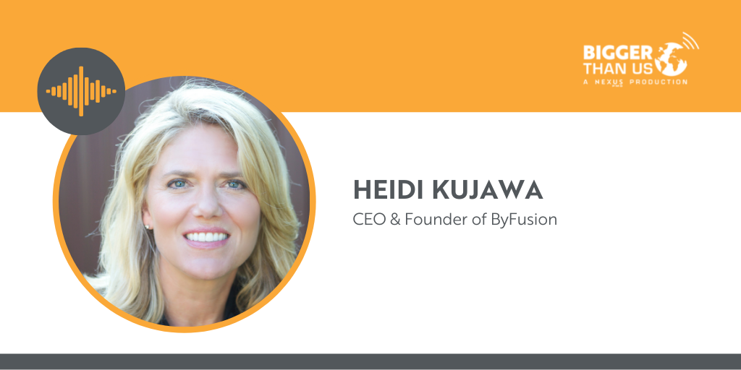
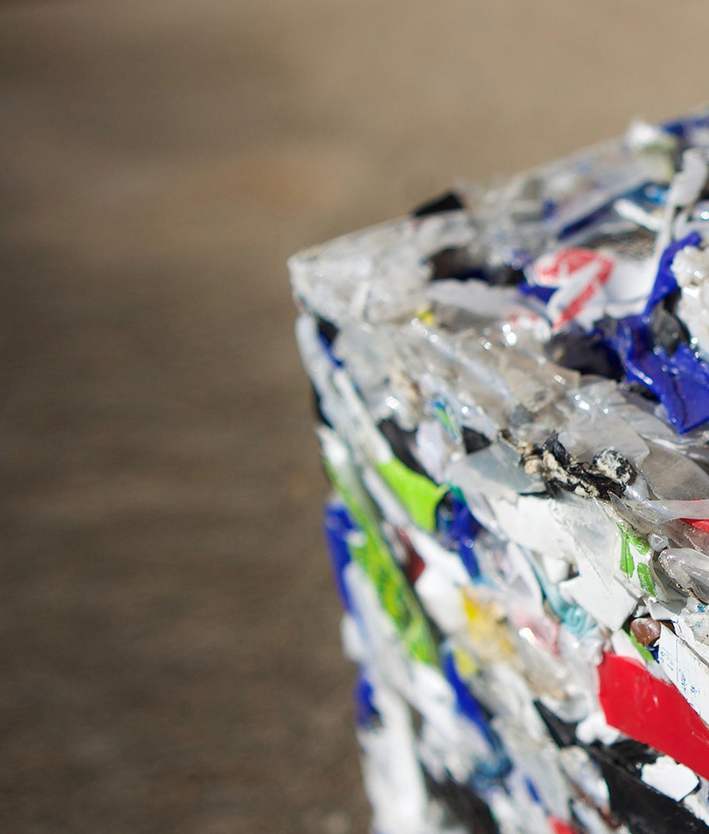
BYFUSION · UNITED STATES
Heidi Kujawa
Difficult-to-recycle plastic
becomes ByBlock
Kujawa founded ByFusion to turn recovered plastics into building products.
Tucson made it visible
Its 2022 pilot produced park benches and a community-centre enclosure.
Portrait: Nexus PMG
Bigger Than Us, 2021
ByBlock photograph: ByFusion
City of Tucson report, January 2023
05
Notes:
Heidi Kujawa is identified as ByFusion's founder and CEO in the Nexus PMG interview published 12 November 2021. ByFusion describes ByBlock as a construction product made from recovered plastic. The City of Tucson reported that its 2022 pilot had led to benches in Himmel Park and San Gabriel pocket park and an enclosure at El Pueblo Community Center. That early pilot shipped collected plastic to California for processing, so it is evidence of visible local products, not proof that all processing was local. This deck makes no claim about 2026 factory operations or universal acceptance of every plastic.
Founder: https://medium.com/bigger-than-us/173-heidi-kujawa-ceo-and-founder-of-byfusion-a96a64b38e38
Product: https://byfusion.com/pages/about
Completed community installations: https://content.govdelivery.com/accounts/AZTUCSON/bulletins/3408f62
Portrait: Nexus PMG / Bigger Than Us, cropped from https://miro.medium.com/v2/resize:fit:1358/1*ujomWCxO6DrAWTggak7YAA.png
ByBlock photograph: ByFusion, https://byfusion.com/cdn/shop/files/ByBlock-close-up_2new_Slide1BG_1.jpg?v=1716234194&width=2400

Slide 6
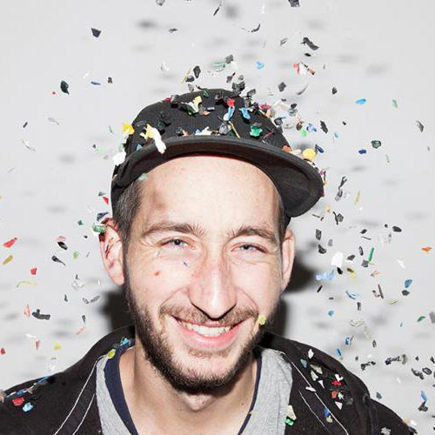
PRECIOUS PLASTIC · AN INTERNATIONAL COMMUNITY
Dave Hakkens and the makers
Open plans let more people make
Hakkens began Precious Plastic in 2013. The community shares machinery designs and know-how for sheets, furniture and everyday objects.
184
530
organisations in the survey
employees reported
Dave Hakkens · Photograph: Precious Plastic
2024 participant survey. Self-reported and unaudited.
06
Notes:
Dave Hakkens started Precious Plastic as a graduation project in 2013. The wider community, rather than one founder alone, develops workshops and products. Its open plans offer a practical starting point for local capability and training. The 2024 impact survey collected responses from 184 organisations and reports 530 employees. These figures cover participating organisations and are self-reported and unaudited. They do not measure all global recyclers, new jobs attributable to one investment, or expected staffing for our facility.
Origins: https://www.preciousplastic.com/about/mission
Products and plans: https://www.preciousplastic.com/
Impact methodology and figures: https://www.preciousplastic.com/results/2024
Portrait identity: https://www.preciousplastic.com/people/version/one
Photo: Precious Plastic, https://assets-global.website-files.com/5e004b03e5da773c54823bfb/5e1001c4096ef4539d9b1272_dave-hakkens.jpg

Slide 7
LESSONS FOR OUR TOWN
What a town
could gain
Useful things close to home
Local buyers help decide what the workshop makes.
Paid work and practical skills
Sales and service income can support trained staff.
Confidence in the result
Public records connect materials to products sold.
Less waste and avoidable transport
Energy and yield records help verify carbon and cost savings.
Classroom in Côte d’Ivoire
© UNICEF / UNI552220 / Dejongh
07
Notes:
The photograph shows a completed classroom project in Côte d'Ivoire, not our proposed UK workshop. The three statements on this slide are goals and design choices for our local proposal. Employment depends on sufficient demand and operating income. Environmental performance must be measured: transport distance alone does not establish lower total emissions. Compare actual energy use, yield, transport, product life and the alternative material or disposal route. Include rejected material and final destinations in the public record. This is how a facility can build confidence without promising that every input becomes a saleable product.
Photograph context: https://www.unicefusa.org/stories/benefits-building-classrooms-out-recycled-plastic-bricks
© UNICEF/UNI552220/Dejongh, https://www.unicefusa.org/sites/default/files/styles/hero_width_scale_width_1400_/public/2024-05/UNI552220%20%281%29.JPG.webp?itok=XKhMIJbq

Slide 8
OUR PROPOSED FIRST STEP
A small workshop with
a clear first job
£18,285
Clean, prepared plastic feed
Small moulded products for local sale
Electric processing with trained staff
Starter equipment estimate
including solar
Public records of materials, energy,
sales and paid hours guide expansion.
Planning estimate from our paper. Site, wages and permissions need separate funding.
Construction blocks and metal processing need their own equipment and validation.
08
Notes:
This is the £18,285 prepared-feed electric starter estimate from our Local Recycling and Manufacturing Paper dated 10 October 2026, not an installed supplier quotation or a funded project. The budget includes solar equipment and allows conditional small aluminium trials in the wider paper, subject to proper site and process validation. The first product focus here is small plastic items. A small injection machine does not make house blocks. Wages, land or suitable premises, permissions and some site-specific work require additional funding. HHO is outside this starter estimate. Solar-assisted direct electric processing is the initial approach. Next steps are to choose a local buyer and product, obtain installed quotes and trial a measured batch before expanding. This does not claim zero emissions, zero residues or guaranteed discounted products.

Slide 9
SOURCES AND PHOTOGRAPHS
The people and the evidence
Gjenge Makers
Precious Plastic
UNEP: Nairobi paving project (2020)
Open plans, products and maker community
Portrait: Georgina Smith / UNEP
2024 impact survey and its limitations
Conceptos Plásticos
The container workshop
Company founders and history
Precious Plastic: Existing container workspace
UNICEF USA: Classrooms and communities (2024)
Dave Hakkens: Community profile and portrait
ByFusion
Other photographs
Nexus PMG: Heidi Kujawa interview (2021)
ByBlock photograph: ByFusion
City of Tucson: Pilot installations (2023)
School photographs: UNICEF / Dejongh
Sources checked 10 October 2026. Figures retain their reported dates.
Full source URLs, photo credits and context appear in PowerPoint speaker notes.
09
Notes:
All source titles on this slide are linked. Additional source for Gjenge's local livelihoods: https://impacc.org/portfolio/gjenge-makers. Precious Plastic origins: https://www.preciousplastic.com/about/mission. Public impact figures are dated to their sources and should not be read as current audited totals. Photographs retain their original subjects; the Heidi Kujawa portrait is cropped from a podcast promotional image. No person in this presentation is represented as endorsing the proposed UK facility. Proposal and budget source: Local Recycling and Manufacturing Paper, 10 October 2026.
Full source index:
unep: https://www.unep.org/news-and-stories/story/building-blocks-greener-nairobi
unepPhoto: https://www.unep.org/news-and-stories/story/meet-seven-women-saving-planet
impacc: https://impacc.org/portfolio/gjenge-makers
conceptos: https://conceptosplasticos.com/content/history.html
unicef: https://www.unicefusa.org/stories/benefits-building-classrooms-out-recycled-plastic-bricks
nexus: https://medium.com/bigger-than-us/173-heidi-kujawa-ceo-and-founder-of-byfusion-a96a64b38e38
byfusion: https://byfusion.com/pages/about
tucson: https://content.govdelivery.com/accounts/AZTUCSON/bulletins/3408f62
pp: https://www.preciousplastic.com/
ppPeople: https://www.preciousplastic.com/people/version/one
ppMission: https://www.preciousplastic.com/about/mission
ppResults: https://www.preciousplastic.com/results/2024
container: https://www.preciousplastic.com/our-solutions/shipping-container
Photo assets:
container: https://cdn.prod.website-files.com/655b100fbab8837a5755c8a0/6a55c5f09a23e909fce41dea_Solutions-Container-cover.jpg
products: https://cdn.prod.website-files.com/655b100fbab8837a5755c8a0/6a55ccae3911dee91ddd8b0d_5e06d156ed2a273e066bde58_hero-landing-products.jpg
nzambi: https://cdn.unenvironment.org/s3fs-public/inline-images/Nzambi_Matee_2020_UNEP_Young_Champions_of_the_Earth_winner_credit_Georgina_Smith_UNEP115-compressed.jpg?VersionId=null
conceptos: https://conceptosplasticos.com/content/images/history_01_CPWeb.jpg
school: https://www.unicefusa.org/sites/default/files/styles/full_width/public/2024-05/UN0616754%20%281%29.jpg.webp?itok=J9QUtyky
heidi: https://miro.medium.com/v2/resize:fit:1358/1*ujomWCxO6DrAWTggak7YAA.png
block: https://byfusion.com/cdn/shop/files/ByBlock-close-up_2new_Slide1BG_1.jpg?v=1716234194&width=2400
dave: https://assets-global.website-files.com/5e004b03e5da773c54823bfb/5e1001c4096ef4539d9b1272_dave-hakkens.jpg
classroom: https://www.unicefusa.org/sites/default/files/styles/hero_width_scale_width_1400_/public/2024-05/UNI552220%20%281%29.JPG.webp?itok=XKhMIJbq

