Slide 1
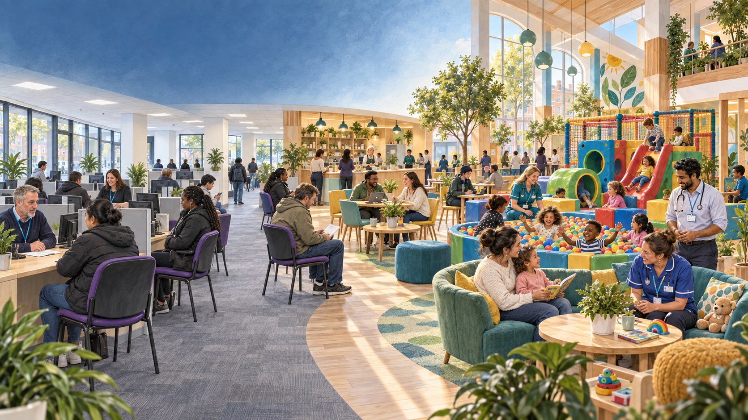
THE FAMILY CENTRE
From Jobcentre
to Family Centre
Living civic support
Before, now and after | a need-led proposal with psychological and financial analysis
Excluding Freudian theory | September 2026
Notes:
Opening frame: this is a proposal for institutional metamorphosis, not a claim that the proposed centre already exists. The visual is a generated concept image, informed by the user-supplied contemporary UK Jobcentre image search and current public-service interiors. It deliberately keeps the present-day Jobcentre recognisable while showing the proposed future as warm, lively and family-supporting.

Slide 2
FRAMING
The change is deeper than a new sign
A name matters only when the institution underneath it changes.
CURRENT INTERFACE
PROPOSED INTERFACE
Claimant or jobseeker
Person, household and community
“Are you meeting the requirement?”
“What would help you live securely, care and contribute sustainably?”
Compliance is highly visible
Need is made discussable
The person’s wider life can disappear
Contribution includes paid work, care, learning and recovery
“True form” is used here as a moral direction: public support organised around human capability. It is not a literal historical claim.
2
Notes:
The proposal separates the symbolic act of renaming from the operational transformation. ‘True form’ is explicitly normative. It means an institution oriented toward the conditions in which people can live, care, learn, recover and participate. It does not claim that a fully integrated Family Centre once existed under another name.

Slide 3
BEFORE
How the institution acquired its present shape
Job matching, benefit administration and conditionality were layered together over time.
1909-10
1970s
late 1980s
2002-06
2024-26
1
2
3
4
5
Labour exchanges
Jobcentres
Functions merge
Jobcentre Plus
Jobs and Careers reform
State labour exchanges organise job matching.
Employment and training support become more visible.
Unemployment benefit offices and job services move closer.
Around 1,500 sites are integrated into about 800 offices.
Government begins shifting toward broader, more personalised support.
The proposed next step is not nostalgia. It is a deliberate reassembly around income security, health, care, learning and participation.
Sources: Labour Exchanges Act 1909; ILO, Key developments in public employment services.
3
Notes:
Sources:
1. Labour Exchanges Act 1909: https://www.legislation.gov.uk/ukpga/Edw7/9/7/contents
2. International Labour Organization, Key developments, role and organization of public employment services: https://researchrepository.ilo.org/esploro/fulltext/book/Key-developments-role-and-organization-of/995219371602676?institution=41ILO_INST&mId=13100786510002676&repId=12100702960002676
The ILO account describes the 1970s replacement of Employment Exchanges by Jobcentres, the later merger with unemployment benefit functions, and the 2002-06 integration into Jobcentre Plus. Dates are simplified for presentation clarity.

Slide 4
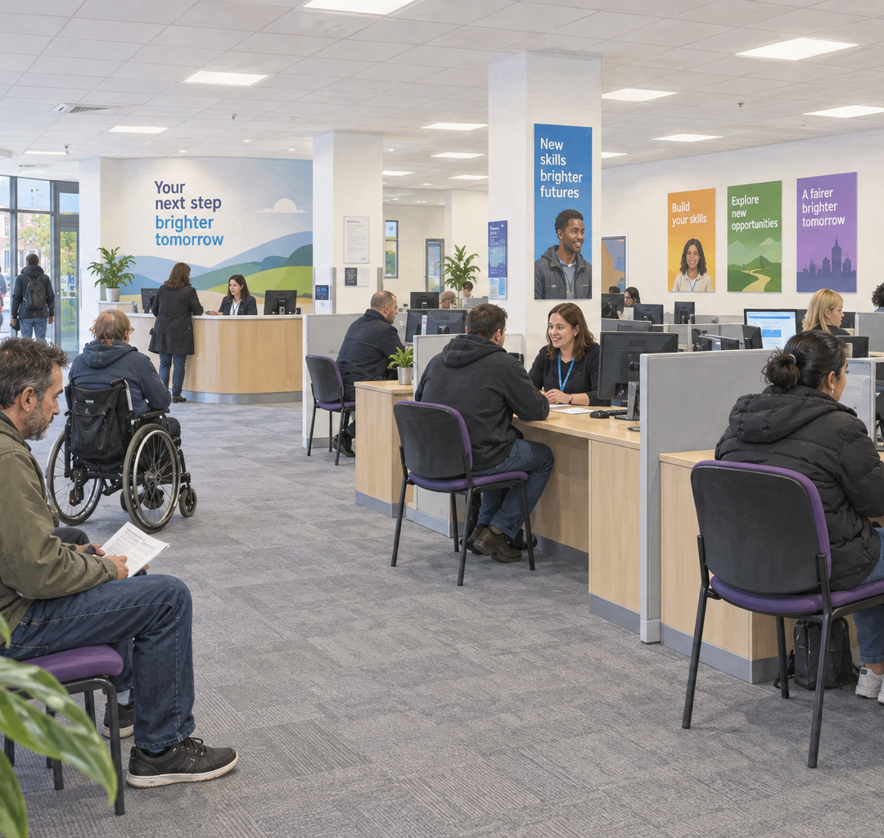
NOW
Ordinary office,
conflicting purposes
What people see
Open-plan desks and computer screens
Appointment-led conversations
Career help beside benefit administration
What the operating model carries
Benefit processes and mandatory contact consume capacity
Personal support reaches people unevenly
Conditionality remains inside the reform path
Concept illustration, not a photograph
4
Notes:
The present is intentionally shown as recognisable rather than sinister. The psychological analysis concerns the rules, incentives, metrics, workload and interactions carried by the space.
Sources:
Get Britain Working, update on the Jobs and Careers Service, 2 July 2026: https://www.gov.uk/government/publications/get-britain-working-an-update-on-the-jobs-and-careers-service/get-britain-working-an-update-on-the-jobs-and-careers-service
The update says the support system was built for past labour-market conditions, that significant Jobcentre capacity is absorbed by benefit processes and appointments, and that support reaches a relatively narrow group unevenly. It states that the National Careers Service merger is scheduled for 1 October 2026. At this presentation date, 16 September 2026, that merger is therefore described as scheduled, not completed.
Get Britain Working White Paper: https://www.gov.uk/government/publications/get-britain-working-white-paper/get-britain-working-white-paper
The White Paper says the system has been too focused on benefits and compliance, while retaining conditionality and sanctions in the reform design.

Slide 5
PSYCHOLOGY
Fear narrows what an institution can notice
Threat can be real without every defensive response being useful.
1 Sources of threat
2 System response
3 Human response
4 Misread feedback
Fraud narratives
Fiscal pressure
Political blame
Error and safeguarding risk
Narrower discretion
More verification
Shorter conversations
Defensive records
Anxiety and vigilance
Guarded disclosure
Cognitive overload
Missed contact
Reduced capacity can appear to be refusal or non-cooperation.
Threat-rigidity is a mechanism, not an accusation: under pressure, organisations often centralise control and rely on familiar routines.
Psychological lens: Staw, Sandelands & Dutton (1981), threat-rigidity theory.
5
Notes:
Psychological analysis excludes Freud. This slide uses organisational threat-rigidity theory. Under perceived threat, groups and organisations may restrict information processing, centralise authority and fall back on well-learned responses. It is a plausible mechanism, not proof that every Jobcentre or staff member acts this way.
Source: Staw, Sandelands and Dutton (1981), Threat-Rigidity Effects in Organizational Behavior, Administrative Science Quarterly. https://www.jstor.org/stable/2392337
Relevant lived-experience evidence: DWP research found that some claimants associated Jobseeker's Allowance with shame and stigma, and that panic or agoraphobia could interfere with compliance. https://assets.publishing.service.gov.uk/media/5a7b44b340f0b66eab9a01c4/810summ.pdf

Slide 6
PSYCHOLOGY
Institutional ego protects roles, metrics and routines
Here, ego means ordinary organisational self-protection. It is not a Freudian concept.
Protective pattern
Counter-condition
“We must defend
what proves our value”
Identity defence
A service can confuse its current procedure with its public purpose.
Purpose reviews led with residents and frontline staff
Status protection
Roles or professional territory can become harder to question.
Shared outcomes and cross-professional governance
Metric ownership
What is counted can become more important than what matters.
Balanced measures, including dignity and stability
Escalation of commitment
Past investment can make a weak routine feel too costly to change.
Independent evidence, pilots and published corrections
Related evidence: Edmondson (1999), psychological safety and learning behaviour.
6
Notes:
‘Ego’ is defined operationally, not psychoanalytically. The idea is that institutions, teams and professions can protect identity, status, metrics and prior decisions. The corrective is not humiliation. It is psychological safety for staff to report error, independent evaluation, cross-professional governance, resident voice and permission to revise.
Source: Amy Edmondson (1999), Psychological Safety and Learning Behavior in Work Teams. https://www.hbs.edu/faculty/Pages/item.aspx?num=2959
The source concerns team learning, not Jobcentres specifically. Its relevance to this proposal is inferential.

Slide 7
PSYCHOLOGY
Two loops can grow from the same encounter
The design choice is whether each contact compounds threat or builds capability.
CONTROL LOOP
CAPABILITY LOOP
1
Threat
1
Safety and dignity
2
Surveillance and pressure
2
Accurate disclosure
3
Stress and guarded disclosure
3
Right support at the right time
4
Poor match or missed contact
4
Capability and contribution
5
Apparent non-cooperation
5
Earned trust
Feeds the original threat story
Makes further honesty safer
Analytical synthesis. These loops are testable hypotheses, not universal laws.
7
Notes:
This is a synthesis of threat-rigidity, administrative-burden, procedural-justice and psychological-safety research. It is a hypothesis about reinforcing feedback, not a claim that every person or office follows the same path. The pilot should measure whether the proposed design actually improves disclosure, matching, trust and sustained outcomes.

Slide 8
PSYCHOLOGY
Design for the conditions in which people can tell the truth
Support improves when people can understand it, influence it and ask for help without avoidable threat.
01
02
03
04
05
Autonomy
Competence
Relatedness
Procedural justice
Low burden
Meaningful choices, voluntary support and consent.
Clear steps, usable tools and achievable progress.
Warm relationships and a sense of belonging.
Voice, neutrality, dignity and trustworthy motives.
Fewer learning, compliance and psychological costs.
Respect is not decoration. It changes the quality of information on which good decisions depend.
Sources: Ryan & Deci (2000); Moynihan, Herd & Harvey (2015); procedural-justice research.
8
Notes:
Sources:
Ryan and Deci (2000), Self-Determination Theory and the facilitation of intrinsic motivation, social development, and well-being: https://pubmed.ncbi.nlm.nih.gov/11392867/
Moynihan, Herd and Harvey (2015), Administrative Burden: Learning, Psychological, and Compliance Costs in Citizen-State Interactions: https://doi.org/10.1093/jopart/muu009
Tom Tyler, procedural justice and legitimacy: https://law.yale.edu/sites/default/files/documents/pdf/Faculty/Tyler_Procedural_Justice_Legitimacy.pdf
These theories do not guarantee a particular outcome. They provide design principles to test.

Slide 9
PRINCIPLE
Need before demand
A humane service begins with the conditions required for life, then builds sustainable participation.
What systems can easily see
What a person may actually need
An appointment kept
Food, heating and enough stability to think
A vacancy applied for
Health care, sleep and recovery
A course accepted
Childcare, eldercare or respite
An online form completed
Transport, devices, data and accessible help
A rapid job start
Skills, decent work and a pace life can sustain
Need-led does not mean limitless provision. It means transparent priorities based on rights, harm, capability and honest resource limits.
Capability lens: evaluate the real freedoms people have, not resources or activity alone.
9
Notes:
The distinction is between human need and what markets or administrative systems can readily observe. A need-led service still has budgets and eligibility rules. The proposal is for transparent priorities based on rights, preventable harm and capability, with routes to challenge decisions.
Capability approach overview: Stanford Encyclopedia of Philosophy, https://plato.stanford.edu/entries/capability-approach/
King's College London qualitative research illustrates how housing, violence, bereavement, lone parenthood, caring, debt, transport, childcare, employer flexibility and digital exclusion shape work capacity: https://www.kcl.ac.uk/csmh/assets/2024/final-kcl-csmh-report-understanding-mental-health-in-the-uk-welfare-system.pdf

Slide 10
FOUNDATION
Financial symbiosis
Public support, household care and local economic activity are interdependent flows.
£1.24tn
Income and services
Essentials and local spend
Firms, jobs and skills
Tax and public capacity
estimated value of unpaid household service work in the UK in 2016
Money circulates
Care and learning
Capability and participation
Equivalent to 63.1% of GDP in that estimate
Maintain people, relationships and future capability.
Paid work, care, recovery, volunteering and learning.
Benefits are transfers, not automatically a net social loss. Evaluation must count what stability enables and avoid double counting.
Source for anchor estimate: ONS, Regional differences in unpaid household service work, 2016.
10
Notes:
Source: Office for National Statistics, Regional differences in unpaid household service work, leisure and unpaid childcare: 2015, published 23 November 2018 and including the 2016 valuation. https://www.ons.gov.uk/economy/nationalaccounts/satelliteaccounts/articles/regionaldifferencesinunpaidhouseholdserviceworkleisureandunpaidchildcare/2015
The ONS estimated unpaid household service work at £1.24 trillion in 2016, equivalent to 63.1% of GDP. This is an old but useful valuation exercise, not a current cash flow.
‘Financial symbiosis’ is the proposal's interpretive frame: public transfers and services can support consumption, health, care, learning and participation, while households and communities produce value that markets do not fully price. This slide does not claim that every pound produces a specific multiplier or saving. Any pilot business case must prevent double counting and distinguish transfers from resource costs.

Slide 11
FOUNDATION
Human development has always been cooperative
Long childhood, shared risk and learned culture make care infrastructure productive infrastructure.
1
Long childhood
Children depend on sustained care and learning beyond one adult.
Modern cooperative infrastructure
2
Shared risk
Income security
Health and prevention
Families and communities pool time, food, knowledge and protection.
Care and safe play
Education and skills
3
Cultural cooperation
Housing and mobility
Belonging and mutual aid
People inherit tools, norms and skills no individual creates alone.
Family means a person and the relationships they rely on: children, partners, friends, carers, chosen family, or nobody currently available.
Evolutionary lens: cooperative breeding, alloparenting and cultural cooperation.
11
Notes:
Evolutionary and anthropological research supports the general proposition that human development is highly cooperative. It does not prescribe one family form or a particular welfare policy.
Sources:
Kenkel et al. (2017), The neuroendocrinology of social attachment and cooperative breeding: https://pmc.ncbi.nlm.nih.gov/articles/PMC5768312/
Boyd and Richerson (2009), Culture and the evolution of human cooperation: https://pmc.ncbi.nlm.nih.gov/articles/PMC2781880/
Martin et al. (2020), Harsh environments promote alloparental care: https://royalsocietypublishing.org/rspb/article/287/1933/20200758/85786/Harsh-environments-promote-alloparental-care
The inclusive definition of family is a design choice intended to avoid excluding people who attend alone, are estranged, are homeless, or rely on chosen relationships.

Slide 12
AFTER
One front door, several kinds of help
The Family Centre coordinates support without turning every need into a case file.
Income and rights
Health
entitlements, debt, advocacy
nurse, doctor, mental health
FAMILY
CENTRE
Care and play
Careers and learning
supervised play, childcare links
skills, work, volunteering
universal civic support
Food and community
Housing and mobility
kitchen, meals, mutual aid
home, transport, digital access
Existing Best Start Family Hubs are a partner and precedent, not something to duplicate. This proposed centre is universal across ages and household forms.
Policy context: Best Start Family Hubs guidance applies in England from April 2026.
12
Notes:
The service model is a proposal. It should integrate with existing provision rather than absorb specialist services indiscriminately. England's Best Start Family Hubs focus on babies, children and families. This proposal broadens the access point to all ages and household forms, while retaining specialist pathways. Scotland, Wales and Northern Ireland require devolved co-design.
Sources:
Best Start Family Hubs and Healthy Babies guidance: https://www.gov.uk/government/publications/best-start-family-hubs-and-healthy-babies-guidance-for-local-authorities
Family Hubs and Start for Life management information, 2022 to 2025: https://www.gov.uk/government/publications/family-hubs-and-start-for-life-management-information-2022-to-2025
Current public-service integration precedent: Parkhead Health and Social Care and Community Hub, Glasgow, combining health, social care, library, pharmacy and café: https://www.ribaj.com/riba-awards/2026/rias-scotland/hoskins-architects-parkhead-health-social-care-community-hub-glasgow/

Slide 13

AFTER
A place built for living
Visits can be quick. Staying can also be useful, comfortable and safe.
What the space must make possible
Substantial supervised soft play and ball pit • approachable nurse and doctor • café, food and water • toilets, changing and feeding • Wi-Fi and charging • quiet and sensory rooms • private consultations • safe staff workspace
Concept illustration
13
Notes:
The visual brief responds directly to the requested calibration: a meaningful ball pit and play environment, children with supervised carers, nurses and doctors visibly available and happy to help, plus ordinary work, advice and community areas. Clinical rooms remain private and properly governed. The play area is supervised, risk-assessed and acoustically separated where necessary. People without children must be equally welcome. Long waits are not part of the model. The image is generated for this proposal and is not a photograph of an existing centre.

Slide 14
AFTER
Care without paternalism
Warmth must be matched by rights, privacy and professional safeguards.
1
2
3
4
5
Universal floor
Voluntary support
Consent and privacy
Voice and remedy
Safe practice
Income security and essential access are not rewards for pleasing staff.
Health, play, learning and advice are offered, not used as covert tests.
Collect the minimum necessary data and separate sensitive records.
Independent advocacy, understandable decisions and real appeal routes.
Clinical governance, safeguarding, accessibility and properly trained staff.
A child-friendly building must never become a family-surveillance building. Voluntary disclosure should not create new sanction routes.
14
Notes:
The major ethical risk is that a welcoming integrated centre could gather more intimate information and increase surveillance. The proposal therefore separates voluntary support from income-security decisions, minimises data collection, establishes role-based access and consent, provides independent advocacy, and prohibits the use of voluntary clinical or family disclosures as new sanction evidence. Clinical care requires normal professional governance. Childcare and play require safeguarding, supervision, inclusion and clear responsibility.

Slide 15
EVALUATION
Outcomes are hypotheses until measured
The centre should be judged by life stability and capability, not footfall or activity alone.
0-6 MONTHS
6-24 MONTHS
2-5 YEARS
Immediate experience
Sustained stability
Community capability
Lower encounter stress
Work or learning when appropriate
Local resilience
Better disclosure and take-up
Health and housing continuity
Less avoidable crisis demand
Faster, more accurate referral
Fewer preventable missed contacts
Institutional trust
More staff learning
Greater parent and carer capacity
Intergenerational capability
Watch for: service dilution • surveillance expansion • clinical delay • cost shifting • play and safeguarding failures
15
Notes:
All outcomes are hypotheses. No causal savings claim is made in advance. Evaluation should report distributional effects, including whether disabled people, lone parents, people from minoritised communities, care leavers, people with no fixed address and people attending alone experience the service differently. Unintended harms must be reported alongside benefits.

Slide 16
EVALUATION
Test the institution before scaling it
A bounded pilot can reveal whether warmth, integration and rights survive operational pressure.
Design
Measure
4-6
Co-design with residents and frontline staff
Trust, wellbeing and resident control
Independent evaluator and comparison sites
diverse pilot sites
Admin time, errors and staff retention
18-24 months
Sustained work, learning, health and housing
Pre-registered protocol and public reporting
Child safety, access and distributional equity
Stop or redesign if the pilot increases poverty, creates coercive sanction pathways from voluntary disclosure, delays clinical care, or fails safeguarding standards.
Pilot scale and duration are proposal assumptions, not current government commitments.
16
Notes:
The pilot numbers are design assumptions for discussion. They are not costed government commitments. Sites should include different nations or, where devolution makes that impractical, different English local contexts plus formal devolved co-design. A causal evaluation could combine matched comparison areas, interrupted time series and qualitative process evidence. Success measures should be pre-registered. Stop rules must override pressure to demonstrate success.

Slide 17
TRANSITION
Metamorphosis is a sequence, not a rebrand
The order matters because trust cannot be requested before material risk is reduced.
1
2
3
4
5
Protect income first
Co-locate voluntary help
Redesign space and roles
Integrate with consent
Scale after evidence
Reduce avoidable fear and make rights understandable.
Bring care, health, advice and learning within reach.
Create play, privacy, comfort and cross-professional teams.
Coordinate budgets and data without building surveillance.
Publish results, correct errors and expand what works.
The goal is not to make people fit the institution. It is to make public support fit the realities of living.
17
Notes:
The transition begins with material security because a warm room cannot compensate for severe conditionality or unstable income. Co-location comes before deeper integration so that services can build trust and learn how to work together. Data integration is intentionally late and conditional on demonstrated consent, role clarity and necessity. Scaling follows evidence rather than political momentum alone.

Slide 18
EVIDENCE
Selected evidence and policy context
Proposal claims and hypotheses are labelled throughout. Full links and methodological notes are in the speaker notes.
UK Government (2024, updated 2025)
Get Britain Working White Paper
Moynihan, Herd & Harvey (2015)
Administrative burden
UK Government (2026)
Update on the Jobs and Careers Service
ONS (2018, data for 2016)
Unpaid household service work
ILO
Key developments in public employment services
King's College London (2024)
Mental health in the UK welfare system
Staw, Sandelands & Dutton (1981)
Threat-rigidity effects
Kenkel et al. (2017)
Cooperative breeding and attachment
Ryan & Deci (2000)
Self-Determination Theory
Boyd & Richerson (2009)
Culture and human cooperation
Edmondson (1999)
Psychological safety and learning
Best Start Family Hubs guidance (2025-26)
Current integration context
Current policy status checked 16 September 2026
18
Notes:
Full source links:
UK Government, Get Britain Working White Paper: https://www.gov.uk/government/publications/get-britain-working-white-paper/get-britain-working-white-paper
UK Government, Update on the Jobs and Careers Service: https://www.gov.uk/government/publications/get-britain-working-an-update-on-the-jobs-and-careers-service/get-britain-working-an-update-on-the-jobs-and-careers-service
Labour Exchanges Act 1909: https://www.legislation.gov.uk/ukpga/Edw7/9/7/contents
ILO, public employment services: https://researchrepository.ilo.org/esploro/fulltext/book/Key-developments-role-and-organization-of/995219371602676?institution=41ILO_INST&mId=13100786510002676&repId=12100702960002676
Staw, Sandelands and Dutton (1981): https://www.jstor.org/stable/2392337
Ryan and Deci (2000): https://pubmed.ncbi.nlm.nih.gov/11392867/
Edmondson (1999): https://www.hbs.edu/faculty/Pages/item.aspx?num=2959
Moynihan, Herd and Harvey (2015): https://doi.org/10.1093/jopart/muu009
ONS unpaid household service work: https://www.ons.gov.uk/economy/nationalaccounts/satelliteaccounts/articles/regionaldifferencesinunpaidhouseholdserviceworkleisureandunpaidchildcare/2015
King's College London welfare and mental health report: https://www.kcl.ac.uk/csmh/assets/2024/final-kcl-csmh-report-understanding-mental-health-in-the-uk-welfare-system.pdf
Kenkel et al. (2017): https://pmc.ncbi.nlm.nih.gov/articles/PMC5768312/
Boyd and Richerson (2009): https://pmc.ncbi.nlm.nih.gov/articles/PMC2781880/
Best Start Family Hubs guidance: https://www.gov.uk/government/publications/best-start-family-hubs-and-healthy-babies-guidance-for-local-authorities
Parkhead integrated hub precedent: https://www.ribaj.com/riba-awards/2026/rias-scotland/hoskins-architects-parkhead-health-social-care-community-hub-glasgow/
Status note: this deck distinguishes current policy, historical evidence, psychological theory, qualitative evidence, design proposals and testable hypotheses.

