Slide 1
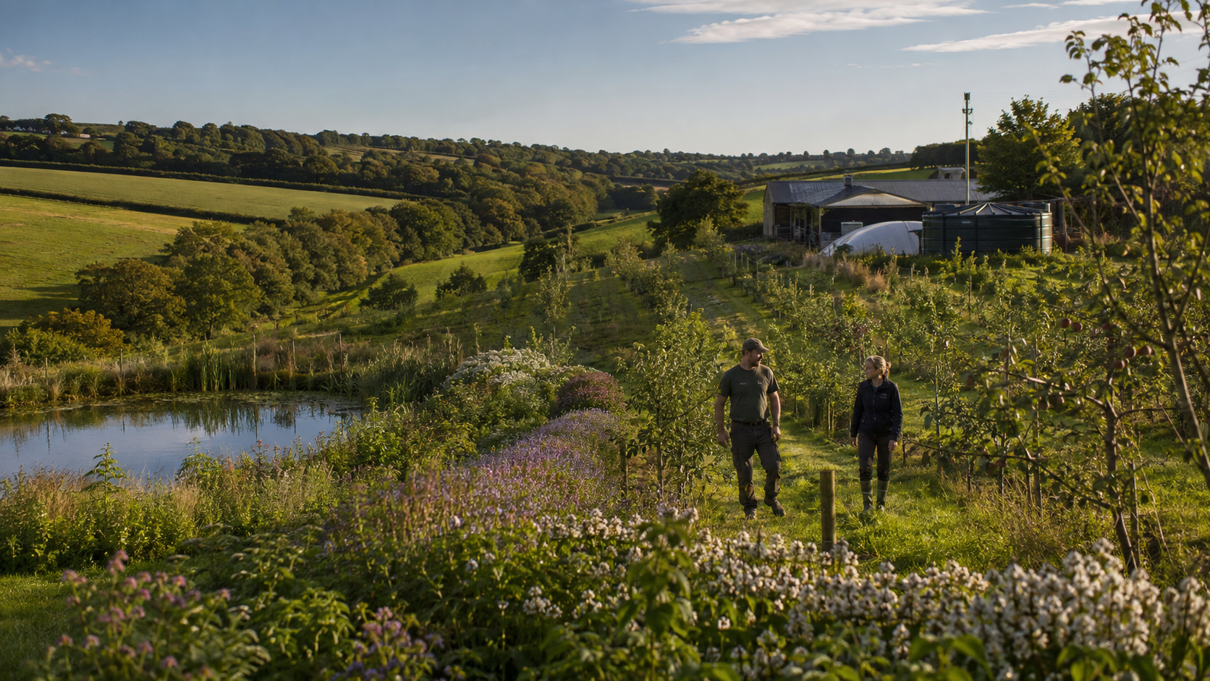
A PRACTICAL UK PROPOSAL
The Perennial
Resilience Plan
Food in two years. Cooler ground in weeks. Water security, living soils and controlled-environment production for land that cannot yet carry a crop.
SECTION 1 Perennial agroforestry
SECTION 2 Green Tent recovery systems
SECTION 3 Aquaponics: full operating model
Decision draft • United Kingdom • August 2026
Notes:
Opening proposition: farm with trees, not instead of farming. The engineering sections are pilot specifications, not claims of perpetual energy.
[Sources]
[/Sources]

Slide 2
EXECUTIVE DECISION
02
Back a staged national pilot—not a leap of faith
Three linked programmes, one measurement framework.
1 Productive perennial farms
2 Recover difficult land
3 Aquaponics done properly
Keep machinery access. Add fast-bearing fruit, nuts, herbs, shelter and water features in measurable strips. Use grants where compatible.
Deploy sealed-loop Green Tents only after contamination, planning and energy studies. Electricity and useful heat come first; hydrogen is optional storage.
Treat fish welfare, biofiltration, aeration, food safety and backup power as core infrastructure. Trees sit in a separated nursery/polishing loop.
ASK Fund 10–20 instrumented demonstrators across UK farm types and degraded-land categories; publish open performance data for 24 months.
UK perennial food, water & controlled-environment farming proposal • 2026
Notes:
Lead with a bounded, measurable pilot. This is the highest-trust route for farmers, investors and officials.
[Sources]
[/Sources]

Slide 3
THE NATIONAL CASE
03
The pressure is visible—and the coalition is plausible
Use quantified need, farmer-operational fit and existing policy instruments.
4,940 Ml/day
+1,000 Ml/day
England public-water deficit projected for 2055 without further action.
Potential wider-economy need beyond public supply.
59%
£630m/year
Cereal farmers surveyed likely or extremely likely to plant trees within five years.
Estimated value of pollination to UK crop production.
UK perennial food, water & controlled-environment farming proposal • 2026
Notes:
[Sources]
- https://www.gov.uk/government/publications/national-framework-for-water-resources-2025-water-for-growth-nature-and-a-resilient-future/3-how-much-additional-water-we-need-national-framework-for-water-resources-2025
- https://cdn.forestresearch.gov.uk/2024/12/Research-Report_Increasing-tree-cover-on-cereal-farms-in-England_final.pdf
- https://www.gov.uk/government/publications/uk-pesticides-national-action-plan-2025/uk-pesticides-national-action-plan-2025-working-for-a-more-sustainable-future
[/Sources]

Slide 4
DELIVERY LOGIC
04
Benefits arrive in layers, not all at once
Protect what exists today; design for fruit within two years and mature resilience later.
1
2
3
4
5
6
DAY 1
WEEKS
MONTHS
1–2 YEARS
2–5 YEARS
5+ YEARS
Retain shade, veteran trees, hedges and wet features. Map operations and risk.
Living cover and mulch reduce exposed-soil heating and splash erosion.
Shelter, infiltration pathways, pollinator strips and root activity establish.
Early fruit and shrub crops; measurable shade, habitat and water outcomes.
Meaningful orchard output, nuts beginning, lower-input perennial understory.
Mature canopy services, diversified income, carbon and long-lived food assets.
Important: “fruit in two years” is achievable with bearing-age or grafted stock, suitable rootstocks, water and aftercare—not a promise for every species or site.
UK perennial food, water & controlled-environment farming proposal • 2026
Notes:
[Sources]
- https://www.rhs.org.uk/fruit/fruit-trees/choosing-the-best
- https://www.gov.uk/government/publications/grow-your-farm-business-how-trees-can-benefit-your-land-crops-and-livestock/grow-your-farm-business-how-trees-can-benefit-your-land-crops-and-livestock
[/Sources]

Slide 5
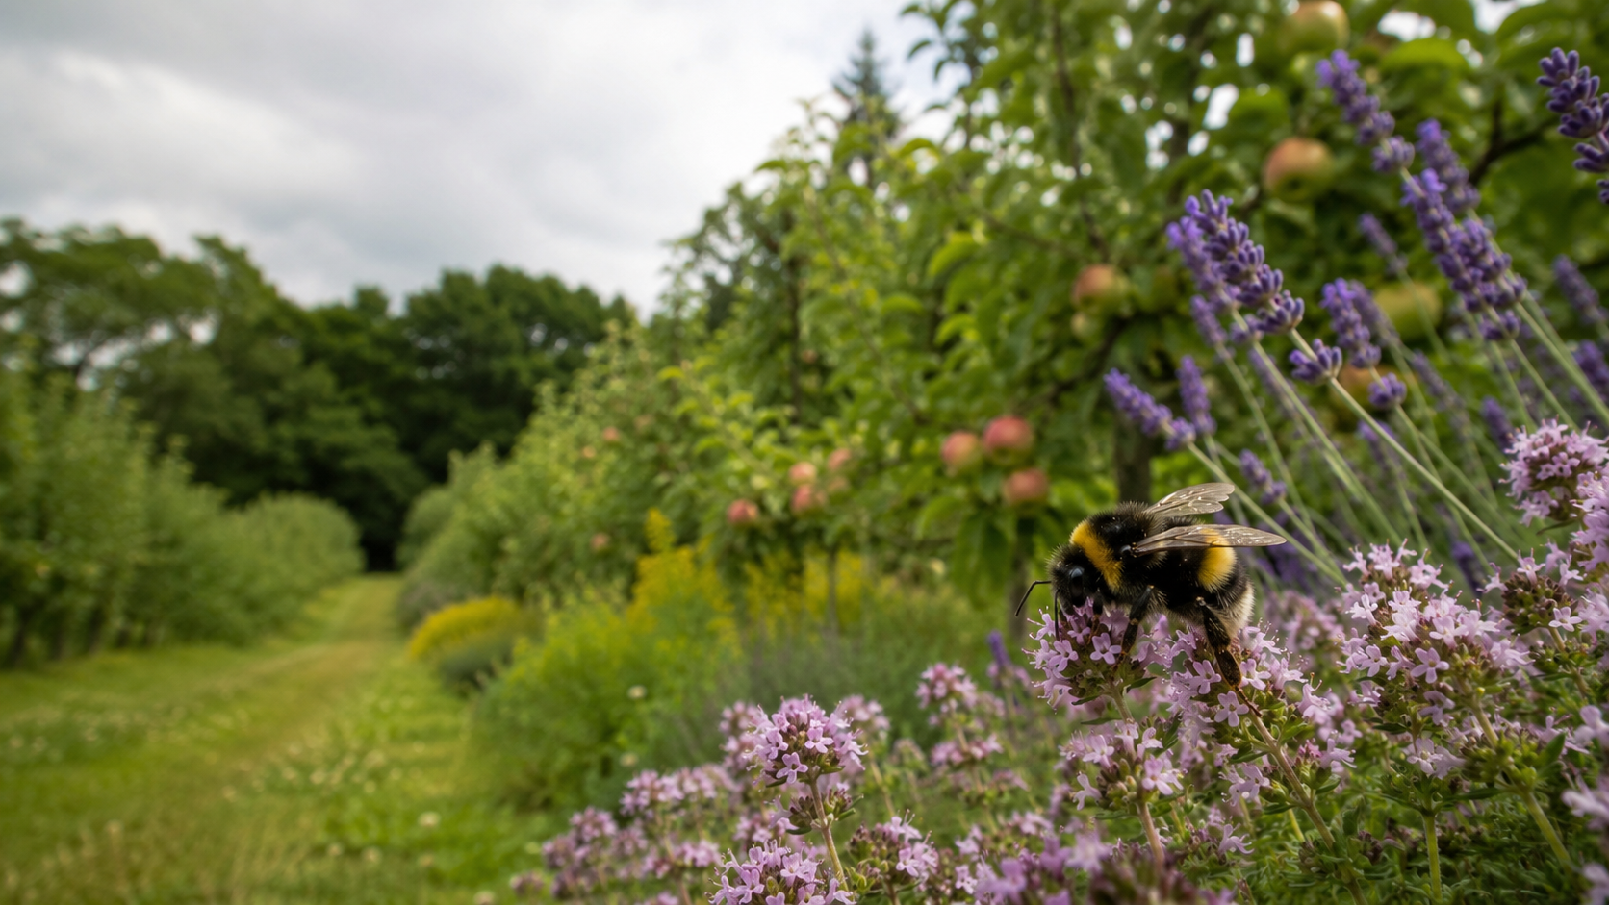
SECTION 1
Farm with trees.
Keep the farm working.
Perennial food, shade, water, herbs, bees and human stewardship—designed around access, cash flow and real farm operations.
Design principle: symbiosis, not domination.
Notes:
Section divider.
[Sources]
[/Sources]

Slide 6
SECTION 1 • LAYOUT
06
Five patterns let trees support production
Start with the constraint: machinery, livestock, water, wind, slope or habitat.
Alley cropping
Rows aligned for machinery; crop alleys remain primary.
10–51 m planned alleys
Silvopasture
Shade/shelter with guarded trees and managed grazing.
30–130 trees/ha
Orchard + understory
Fruit/nuts over herbs, soft fruit and groundcover.
Highest food diversity
Riparian/runoff belts
Trees and wet features intercept flow and protect water.
Site-led spacing
Hedges & shelterbelts
Fastest operational entry: edges, corners and wind lines.
Low land take
UK perennial food, water & controlled-environment farming proposal • 2026
Notes:
[Sources]
- https://www.gov.uk/government/publications/funding-and-grants-for-agroforestry/funding-and-grants-for-agroforestry
- https://www.gov.uk/countryside-stewardship-grants/af2-plant-an-agroforestry-fruit-tree
[/Sources]

Slide 7
SECTION 1 • FOOD TIMING
07
Build the two-year harvest from several layers
First useful harvest ranges assume healthy, established stock and a suitable site.
YEAR 1–2
YEAR 2–4
YEAR 4+
Dwarf/semi-dwarf apple*
Fig in a sheltered site
Elder
Currants & gooseberries
Raspberries
Rhubarb & perennial herbs
Plum & damson
Pear & quince
Sour cherry
Medlar & mulberry
Sea buckthorn
Globe artichoke
Hazel, sweet chestnut
Walnut
Carob: H3 pilot only
Honey locust: selected fodder types
Oak/acorns: processed food
Long-lived canopy trees
*Grant compatibility warning: some England agroforestry actions require semi-vigorous or vigorous fruit-tree rootstocks; ultra-dwarf early-bearing trees may need a separate orchard/edge budget.
UK perennial food, water & controlled-environment farming proposal • 2026
Notes:
[Sources]
- https://www.rhs.org.uk/fruit/fruit-trees/choosing-the-best
- https://www.rhs.org.uk/plants/3403/ceratonia-siliqua/details
- https://www.gov.uk/countryside-stewardship-grants/af2-plant-an-agroforestry-fruit-tree
[/Sources]

Slide 8
SECTION 1 • SPECIES PORTFOLIO
08
Sweet, savoury and staple trees—without unsafe “bean tree” shortcuts
Pilot marginal species; prioritise proven UK fruit, nuts, shrubs and perennial herbs.
ROLE
RELIABLE CORE
CONDITIONAL / PILOT
AVOID AS GENERAL FOOD
Sweet
Apple, pear, plum, damson, quince, cherry, medlar
Fig, mulberry, sea buckthorn
Ornamental cherries without edible ID
Savoury / staple
Hazel, sweet chestnut, walnut; processed acorns
Carob in H3/mild protected sites; selected honey locust fodder
Laburnum; catalpa pods; black locust as routine food
Understory
Currants, gooseberries, raspberry, rhubarb, herbs
Sea beet, capers in mild sites
Unverified “edible” internet claims
Support
Alder where suitable, willow, native hedge mix, clover/vetch
Mesquite only after invasive-risk review
Known invasive or toxic species
Rule: common names such as “bean tree” are not proof of edibility. Use botanical identification, food-safety evidence and UK invasiveness checks.
UK perennial food, water & controlled-environment farming proposal • 2026
Notes:
[Sources]
- https://www.rhs.org.uk/plants/3403/ceratonia-siliqua/details
- https://www.rhs.org.uk/prevention-protection/invasive-non-native-plants
[/Sources]

Slide 9
SECTION 1 • PERENNIAL UNDERSTORY
09
Herbs provide food while the canopy is still young
Design strips for harvesting, beneficial insects, soil cover and controlled spread.
KITCHEN
FOOD CROPS
Rosemary • thyme • sage • oregano • chives • lovage • sorrel • tarragon • fennel
Asparagus • rhubarb • globe artichoke/cardoon • perennial kale • wild garlic • sea beet
POLLINATORS
SOIL & BIOMASS
Lavender • hyssop • yarrow • bee balm • angelica • knapweed • borage*
White/red clover • vetch • comfrey* • contained mint/lemon balm • managed nettle patches
*Some useful species self-seed or spread strongly: site, contain and harvest them intentionally.
UK perennial food, water & controlled-environment farming proposal • 2026
Notes:
[Sources]
- https://www.rhs.org.uk/plants/for-pollinators
[/Sources]

Slide 10
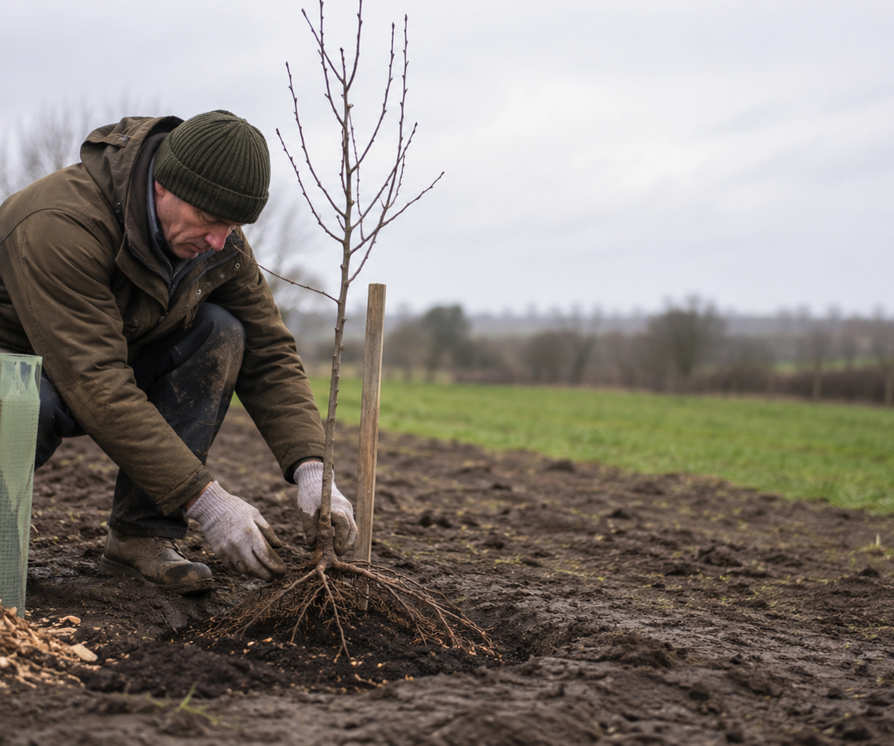
SECTION 1 • ESTABLISHMENT
10
How to plant a fruit tree so it can actually succeed
Dormant-season bare-root planting is economical; avoid frozen or waterlogged soil.
1 Map services, drains, access, shade and legal constraints.
2 Match species, cultivar and rootstock to soil, climate and use.
3 Dig broad, not deep; loosen sides. Do not bury the stem.
4 Spread roots; set the root collar level with finished ground.
5 Backfill native soil and firm gently—no fertiliser pocket.
6 Add low stake/tie and a guard or fence matched to livestock/deer.
7 Create a 1 m weed-free mulch zone; keep mulch off the trunk.
UK perennial food, water & controlled-environment farming proposal • 2026
Notes:
[Sources]
- https://www.gov.uk/countryside-stewardship-grants/supply-and-plant-tree-te4
- https://cdn.forestresearch.gov.uk/2022/02/stokes_2012_qjf_mulches_zdklgwc.pdf
[/Sources]

Slide 11
SECTION 1 • FIRST 24 MONTHS
11
Aftercare is the difference between planting and establishment
Budget the maintenance before buying the trees.
0–3 MONTHS
FIRST SUMMER
FIRST WINTER
SECOND YEAR
Water in; inspect after wind; check guards and ties; replace washouts.
Deep, less-frequent watering; maintain 1 m weed-free zone; record survival and stress.
Replace failures; formative prune only; repair fencing; review drainage and browsing.
Repeat drought plan; release tight ties; monitor pests/disease; begin small harvest records.
SURVIVAL
WATER
FORM
YIELD
Minimum dashboard survival % • litres/tree • replacement rate • labour hours • first crop kg • pest interventions
UK perennial food, water & controlled-environment farming proposal • 2026
Notes:
[Sources]
- https://www.gov.uk/countryside-stewardship-grants/supply-and-plant-tree-te4
[/Sources]

Slide 12
SECTION 1 • BEES AND CROP PROTECTION
12
Pesticide-last is agronomy, not blame
Use prevention and thresholds; retain targeted tools for genuine need.
1
PREVENT
Resistant cultivars, rotation, habitat, nutrition and hygiene.
2
MONITOR
Scouting, traps, weather data and action thresholds.
3
PHYSICAL / BIOLOGICAL
Barriers, pruning, predators, parasitoids and approved biocontrols.
4
TARGETED INTERVENTION
Lowest-risk effective option, correct timing and no routine blanket spraying.
National Action Plan target: reduce each of 20 Pesticide Load Indicator metrics by at least 10% by 2030 from a 2018 baseline.
UK perennial food, water & controlled-environment farming proposal • 2026
Notes:
[Sources]
- https://www.gov.uk/government/publications/uk-pesticides-national-action-plan-2025/uk-pesticides-national-action-plan-2025-working-for-a-more-sustainable-future
[/Sources]

Slide 13
SECTION 1 • BUSINESS WATER RESILIENCE
13
Make one year of demand visible, funded and resilient
Proposed obligation: annual-equivalent resilience—not necessarily a year of water in one onsite tank.
ONSITE
CIRCULAR
Covered, opaque tanks; screened vent; first flush; overflow; inspection.
Process-water recycling, rainwater, condensate recovery and demand reduction.
SHARED
PHASED
Catchment reservoirs, wetlands, aquifer recharge or contracted strategic storage.
25% → 50% → 100% annual-equivalent resilience with sector-specific safety rules.
Engineering correction: water evaporates because molecules escape into the air; being a solvent mainly affects material compatibility and contamination. Tanks should be closed/covered—not airtight—and must have safe vents and overflow.
UK perennial food, water & controlled-environment farming proposal • 2026
Notes:
[Sources]
- https://www.gov.uk/government/news/england-faces-5-billion-litre-public-water-shortage-by-2055-without-urgent-action
- https://www.flintshire.gov.uk/en/PDFFiles/Flooding-and-Drainage/Appendix-G-NWFRMG-SuDS-Guide.pdf
[/Sources]

Slide 14
SECTION 1 • HUMAN ECOLOGY
14
Resident stewards can guard the asset—if the arrangement is lawful and fair
Translate “hippies among the trees” into a credible stewardship model.
THE OPPORTUNITY
NON-NEGOTIABLE SAFEGUARDS
On-site presence can deter damage, spot leaks and fire risks, maintain guards, prune dead material, record wildlife and coordinate harvests.
Planning and housing compliance • safe sanitation and water • written rights • residency not coercively tied to unpaid labour • paid scheduled work • insurance • safeguarding • clear governance and exit routes.
Best model community land trust, cooperative tenancy or paid farm-steward role with transparent duties—not informal dependency.
UK perennial food, water & controlled-environment farming proposal • 2026
Notes:
[Sources]
- https://www.gov.uk/government/publications/planning-practice-guidance
[/Sources]

Slide 15
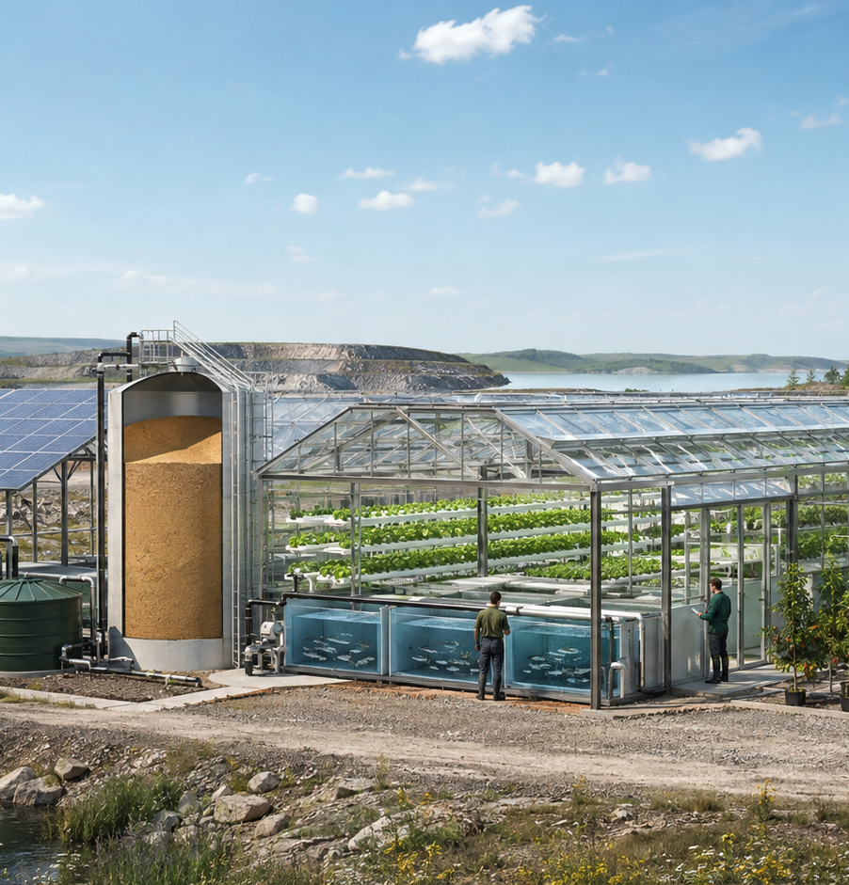
SECTION 2
Make difficult land
productive again.
A controlled-environment food, heat and water system for quarries, compacted sites and contained brownfield land.
No mixed HHO. No perpetual-energy claim.
Separate loops. Meter every conversion.
Notes:
Section divider.
[Sources]
[/Sources]

Slide 16
SECTION 2 • ARCHITECTURE
16
The Green Tent is five separate loops joined by heat exchangers and controls
Separation protects fish, food, operators and the energy balance.
PV + grid/battery → pumps, aeration, controls
Never sacrifice life-support loads
ELECTRICAL
Surplus electricity/solar heat → sand store → useful heat
Direct heat before reconversion
THERMAL
Rated boiler/expander → condenser cube → feedwater return
Closed clean-water loop
CLEAN STEAM
Fish → solids → biofilter → plants → sump
Nutrient water is never boiled
AQUAPONICS
Dehumidify, treat condensate; plants/algae use compatible CO₂
Test, meter and verify fate
WATER / CO₂
UK perennial food, water & controlled-environment farming proposal • 2026
Notes:
[Sources]
- https://www.energy.gov/cmei/fuels/hydrogen-production-electrolysis
- https://energy.sandia.gov/programs/renewable-energy/concentrating-solar-thermal-technologies/thermal-energy-storage-tes/
[/Sources]

Slide 17
SECTION 2 • ENERGY
17
Use each joule where it has the highest value
The proposal succeeds by avoiding unnecessary conversions.
1
DIRECT ELECTRICITY
PV/grid → pumps, controls, lighting, heat pumps
2
DIRECT HEAT
Solar thermal/resistive input → sand store → greenhouse/fish/root-zone heat
3
POWER RECOVERY
ORC or steam expander only if temperature, scale and economics justify
4
HYDROGEN
Certified electrolyser with separated H₂/O₂ for sale or seasonal backup
Reject: storing mixed “HHO”. Hydrogen and oxygen must remain separated; accumulation with oxygen creates a serious fire/explosion hazard.
UK perennial food, water & controlled-environment farming proposal • 2026
Notes:
[Sources]
- https://www.energy.gov/cmei/fuels/hydrogen-production-electrolysis
- https://www.iea.org/reports/unlocking-ukraines-hydrogen-opportunity-a-roadmap/unlocking-the-opportunity-a-roadmap-for-action
- https://www.hydrogen.energy.gov/docs/hydrogenprogramlibraries/pdfs/review05/pdp_39_pile.pdf
[/Sources]

Slide 18
SECTION 2 • STEAM CONDENSATION & HEAT RECOVERY CUBE
18
Recover condensate and latent heat without turning the greenhouse into a disease chamber
A named subsystem for engineer review—not an off-the-shelf promise.
SAND STORE
RATED BOILER
EXPANDER*
CONDENSER CUBE
RETURN TANK
Heat source
→
Clean feedwater
→
Optional power
→
Heat + water recovery
→
Polished condensate
• Condenser heat goes through a heat exchanger to fish water, root zones or space heating.
• Greenhouse humidity is controlled by dehumidification/condensing surfaces—not by injecting free steam.
• Condensate is tested and treated before reuse; corrosion chemistry and food safety matter.
• *Prefer direct heat. ORC/steam power only after a bankable heat-grade and duty-cycle study.
UK perennial food, water & controlled-environment farming proposal • 2026
Notes:
[Sources]
- https://www.sciencedirect.com/science/article/abs/pii/S153751101500183X
- https://pmc.ncbi.nlm.nih.gov/articles/PMC11625998/
[/Sources]

Slide 19
SECTION 2 • SITE RECOVERY
19
“Unfarmable” is a diagnosis, not a single land type
Contain contamination, import clean growing media and prove the carbon claim.
QUARRY / HARDSTAND
COMPACTED / SALINE
BROWNFIELD
Modular foundations; capture roof water; wind and drainage design.
Raised contained beds; manage salts; avoid contact with hostile soil.
Phase I/II contamination assessment; sealed floor and clean logistics.
CO₂ pathway
Plants and algae can use compatible CO₂, but “scrubbing” is not permanent removal unless carbon is stored or displaced credibly. Measure the whole life cycle. Route safe biomass to products, soil amendment or engineered biochar; screen any exhaust for contaminants first.
Hydrogen combustion makes water—not CO₂. Keep the carbon loop separate.
UK perennial food, water & controlled-environment farming proposal • 2026
Notes:
[Sources]
- https://www.gov.uk/government/publications/direct-air-capture-and-greenhouse-gas-removal-innovation-programme-selected-projects/direct-air-capture-and-greenhouse-gas-removal-innovation-programme-phase-2-projects
- https://pmc.ncbi.nlm.nih.gov/articles/PMC11368733/
[/Sources]

Slide 20
SECTION 3
FISH TANK
Aquaponics:
a living treatment plant
that also grows food.
feed → fish → ammonia
→
BIOFILTER
ammonia → nitrite → nitrate
Fish, microbes, plants, water chemistry and backup power must be designed as one biological system.
→
PLANT BEDS
roots take nutrients • clean water returns
Notes:
[Sources]
- https://openknowledge.fao.org/handle/20.500.14283/i4021e
[/Sources]

Slide 21
SECTION 3 • THE LOOP
21
How aquaponics works
Water recirculates; feed, oxygen, top-up water and careful management still enter.
1 FEED + FISH
Protein enters; fish grow and excrete ammonia.
5 SUMP + PUMP
2 SOLIDS
Water returns to fish with oxygen and stable flow.
Settle/remove faeces and uneaten feed; mineralise safely.
24/7
AERATION
4 PLANTS
3 BIOFILTER
Roots take nitrate and other nutrients; clean water leaves.
Nitrifying microbes convert ammonia to plant-available nitrate.
UK perennial food, water & controlled-environment farming proposal • 2026
Notes:
[Sources]
- https://openknowledge.fao.org/handle/20.500.14283/i4021e
[/Sources]

Slide 22
SECTION 3 • BIOLOGY
22
The nitrogen cycle is the engine
Nitrifying communities need oxygen, surface area, alkalinity, stable temperature and time.
FISH + FEED
AMMONIA OXIDISERS
NITRITE OXIDISERS
PLANT ROOTS
NH₃ / NH₄⁺
NO₂⁻
NO₃⁻
BIOMASS
→
→
→
Toxicity rises with pH and temperature
Nitrite interferes with oxygen transport
Often dominated by Nitrospira-like organisms
Harvest exports nitrogen from the loop
Operating compromise
Many systems target roughly pH 6.8–7.2, but the safe range is species- and design-dependent. Track pH, alkalinity, dissolved oxygen, temperature, total ammonia, nitrite, nitrate and flow—then respond to trends, not one number.
UK perennial food, water & controlled-environment farming proposal • 2026
Notes:
[Sources]
- https://openknowledge.fao.org/handle/20.500.14283/i4021e
[/Sources]

Slide 23
SECTION 3 • GROW MEDIA
23
Volcanic rock can host roots and bacteria—but it is not magic
Media beds combine plant support, biofilm habitat and some solids handling.
WASHED LAVA / PUMICE
EXPANDED CLAY
WASHED GRAVEL / GLASS FOAM
Porous and high-surface-area. Test that it is inert and food-safe. Typical coarse media is roughly 12–20 mm. Heavy beds need structural design; sharp edges and trapped solids need management.
Light, plant-friendly and easy to handle, but more expensive and can float initially. Useful where structure or ergonomics matters.
Locally available options may reduce cost. Check pH reaction, contaminants, grading, abrasion and embodied impacts.
Design rule pre-filter solids before dense media; provide clean-outs and avoid anaerobic pockets. Never use unknown demolition aggregate.
UK perennial food, water & controlled-environment farming proposal • 2026
Notes:
[Sources]
- https://openknowledge.fao.org/handle/20.500.14283/i4021e
[/Sources]

Slide 24
SECTION 3 • SYSTEM CHOICE
24
Match the hydraulic system to crop, solids load and operator skill
Core aquaponics favours fast crops; trees belong in a separated nursery or polishing loop.
SYSTEM
BEST FIT
STRENGTH
WATCH
Flood-and-drain media
Herbs, mixed crops
Tolerant, accessible
Heavy; solids can accumulate
Deep-water culture
Leafy greens
Stable root-zone water
Needs good solids removal
NFT channels
Small leafy crops
Low water volume
Sensitive to blockage/pump failure
Dutch buckets / wicking
Fruiting crops
Modular root volume
More plumbing and balancing
Tree nursery / orchard loop
Young trees, shrubs
Uses filtered purge water
Separate hydraulics; roots must not clog fish loop
UK perennial food, water & controlled-environment farming proposal • 2026
Notes:
[Sources]
- https://openknowledge.fao.org/handle/20.500.14283/i4021e
- https://pmc.ncbi.nlm.nih.gov/articles/PMC11317483/
[/Sources]

Slide 25
SECTION 3 • COMMISSIONING
25
Cycle the biology before loading the system
A typical biofilter may need roughly 4–8 weeks; temperature, inoculum and loading change the timing.
WEEK 0
WEEKS 1–2
WEEKS 2–6
GO / NO-GO
Leak test • disinfect/rinse appropriately • verify materials • calibrate probes
Fishless or very low-load cycling • add ammonia source responsibly • run aeration 24/7
Watch ammonia rise/fall, then nitrite rise/fall; protect alkalinity and oxygen
Only stock gradually when both conversion steps are demonstrated under a test load
Daily
temperature • dissolved oxygen • flow • fish behaviour • mortalities
Frequent / trend-based
pH • alkalinity • ammonia • nitrite • nitrate • make-up water • feed • plant deficiency
UK perennial food, water & controlled-environment farming proposal • 2026
Notes:
[Sources]
- https://openknowledge.fao.org/handle/20.500.14283/i4021e
[/Sources]

Slide 26
SECTION 3 • OPERABILITY
26
Aeration and flow are life-support systems
Design failure modes before selecting fish or crops.
REDUNDANCY
BIOSECURITY
Dual air pumps • UPS/battery • high/low water alarms • gravity overflow • spare pump • isolation valves
Quarantine • controlled movements • mortality plan • cleaning zones • trained staff • welfare checks
FOOD SAFETY
UK COMPLIANCE
Potable-quality top-up • backflow prevention • HACCP • chemical/pathogen controls • clean harvest areas
Register cropping-water/aquaponic systems where required • authorise species and movements • planning, abstraction/discharge and waste checks
Species choice follows water temperature and permissions: trout suit cool systems; tilapia generally need heat and non-native controls. Do not choose fish from yield spreadsheets alone.
UK perennial food, water & controlled-environment farming proposal • 2026
Notes:
[Sources]
- https://www.gov.uk/guidance/register-a-fishery-cropping-water-or-aquaponic-system
[/Sources]

Slide 27
IMPLEMENTATION
27
A 24-month pilot converts conviction into investable evidence
Stage gates protect farmers, fish, public money and community trust.
0–3 mo
3–6 mo
6–12 mo
12–24 mo
SELECT
DESIGN
BUILD
PROVE
Sites, partners, baseline water/soil/energy, permissions and independent engineering review.
Planting plans, hydraulic models, hazard studies, procurement and steward agreements.
Plant first tree strips; commission water storage; construct one Green Tent/aquaponic demonstrator.
Publish survival, yield, input, welfare, water, energy, carbon and financial data.
Publish the failures too. Open operating data is the fastest route from “interesting idea” to standards, finance and farmer confidence.
UK perennial food, water & controlled-environment farming proposal • 2026
Notes:
[Sources]
- https://cdn.forestresearch.gov.uk/2024/12/Research-Report_Increasing-tree-cover-on-cereal-farms-in-England_final.pdf
[/Sources]

Slide 28
DECISION
Start where benefits arrive fastest.
Measure what takes longer.
01
Protect and map existing perennial assets now.
02
Fund fast-bearing perennial strips and aftercare this planting season.
03
Create an annual-equivalent business water resilience standard.
04
Commission one independently reviewed Green Tent + aquaponics pilot.
05
Publish two years of open technical, welfare and financial results.
Food • water • shade • soil • energy • skills
Engineering detail to be completed by qualified multidisciplinary teams.
Notes:
Close on the staged decision and invite an engineering/farmer working group.
[Sources]
[/Sources]

